Slide 1
Business
plan
REACH Hub
Resources for Entrepreneurship Advising & Coaching

Slide 2
REACH Hub | Business plan
Our approach
Throughout the REACH Hub, we aim to ensure that resources SPEAK, that is, that they are:
Simple – clear and without unnecessarily complication
Psychological – focused on helping entrepreneurs think effectively
Empowering – centered on SEDI populations
Aligned – relevant to and linked with other approaches
Knowledge-based – built on research-based insights

Slide 3
REACH Hub | Business plan
Our approach
Throughout the REACH Hub, we aim to ensure that resources SPEAK, that is, that they are:
Simple – clear and without unnecessarily complication
Psychological – focused on helping entrepreneurs think effectively
Empowering – centered on SEDI populations
Aligned – relevant to and linked with other approaches
Knowledge-based – built on research-based insights
Helpful call-outs
Throughout this presentation, there are special slides that provide additional information. They are indicated by transparent grey backgrounds like this one.
Mindset: this logo indicates that the call-out is related to an entrepreneurial mindset – a topic covered in the Reach Hub’s Entrepreneurial Mindset Training
Coach/advisor tip: this logo indicates that the call-out is related to advice designed for a coach or advisor who is working with a small business or entrepreneur
Links are underlined
This presentation includes links to other resources in the REACH Hub indicated by underlined text

Slide 4
REACH Hub | Business plan
Purpose
The purpose of this presentation is to provide you an introduction to business plans – both their uses and the information that goes in them. Building a business plan is often the next step following putting together a business idea sketch and pitch deck, and it is often a critical step before an entrepreneur seeks money for their business from banks or other investors. As seen on the next slide, this presentation is meant to be viewed after engaging with the Business Pitch and Business Idea Sketch presentations.
Disclaimer:
The information provided in this content does not, and is not intended to, constitute: legal advice, accounting, tax, financial advice, an offer to buy or sell securities, nor is it intended as financial or investment advice; instead, all information, content, and materials available in this content are for general educational purposes only. Information in this content may not constitute the most up-to-date legal, financial, accounting, financial, or investment information. The content may contain links to other third-party websites and to content generated by third parties. Such links and content are only for the convenience of the user; the authors of this content do not recommend or endorse the content of any third-party sites or content.

Slide 5
REACH Hub | Business plan
Equity-based
investment
Debt- and other financing
Introduction to financing
ESOPs
Contracts
Financial management
Accounting basics: tax & audits
Making it official & attorneys
Business plan
Basics of bookkeeping
Business pitch
Business idea sketch

Slide 6
REACH Hub | Business plan
Overview
What is a business plan and what is it used for?
Parts of a business plan
Recommendations for writing a business plan
Summary
What’s next

Slide 7
REACH Hub | Business plan
Overview
What is a business plan and what is it used for?
Parts of a business plan
Recommendations for writing a business plan
Summary
What’s next

Slide 8
REACH Hub | Business plan
Business plans
A business pitch is a document that outlines a company’s goals and the plans to achieve them.
Business pitches are written out – often in relatively great detail across 10s or 100s of pages;
Business plans are helpful even if a business doesn’t need funding.
[Name of business]
Business plan
Prepared for
[Name of lender/investor]
Prepared by
[Name of author]

Slide 9
REACH Hub | Business plan
Uses of the business plan
There are at least three purposes for business plans:
Type of use | Note
Laying a roadmap: detailing a business idea, its goals, and the plans to meet those goals, for the entrepreneur and those they are working with | Most entrepreneurs have found it more effective in terms of time to build out the basics of their idea and plan in a pitch deck rather than write a long business plan
Communication: communicate a vision for the future of a business to others including potential employees or partners | Many potential employees or partners are often busy, thus it is a good idea to summarize main points from a business plan with the use of a pitch deck – often these can be sent together to someone to allow them a quick, and then a more detailed picture of topics where needed (see the Business Idea Pitch module)
Fundraising: attracting investment from potential investors – either debt-based or equity-based | Business plans are often required to obtain money from a bank or investor; you will be judged on the business idea but also your thoughtful analysis and professional writing

Slide 10
REACH Hub | Business plan
Overview
What is a business plan and what is it used for?
Parts of a business plan
Recommendations for writing a business plan
Summary
What’s next

Slide 11
REACH Hub | Business plan
Parts of a business plan
Part | Description
Executive summary | Introduces the company, its mission statement, goals, and a summary of other sections in the business plan
Business description | A more detailed overview of the company, market needs, legal structure, business history, and the long-term goals of the business
Products/services | A detailed explanation of products or services that the business offers or plans to offer
Market/competitive analysis | Key facts about the industry the business operates in, the size of the market the business hopes to sell to, and insight into competitors
Organization/management | A description of company ownership and management – and a profile of key employees, advisors, or board members
Marketing/sales strategy | Strategy and plan to engage with, sell, and distribute products/services to customers – including issues of customer retention and branding
Operations plan | Details on how the business operates on a day-to-day basis including logistics, suppliers, production methods and key technology
Financial plans & projections | A review of past performance and future projections – including key financial statements and a break-even analysis
Funding request | Specify how much money the business needs and for what purposes, including what form of investment you are seeking and desired terms
Appendix | An appendix holds supporting documents, often including details on key people, product/services, and legal and financial matters

Slide 12
REACH Hub | Business plan
Parts of a business plan
Part | Description
Executive summary | Introduces the company, its mission statement, goals, and a summary of other sections in the business plan
Business description | A more detailed overview of the company, market needs, legal structure, business history, and the long-term goals of the business
Products/services | A detailed explanation of products or services that the business offers or plans to offer
Market/competitive analysis | Key facts about the industry the business operates in, the size of the market the business hopes to sell to, and insight into competitors
Organization/management | A description of company ownership and management – and a profile of key employees, advisors, or board members
Marketing/sales strategy | Strategy and plan to engage with, sell, and distribute products/services to customers – including issues of customer retention and branding
Operations plan | Details on how the business operates on a day-to-day basis including logistics, suppliers, production methods and key technology
Financial plans & projections | A review of past performance and future projections – including key financial statements and a break-even analysis
Funding request | Specify how much money the business needs and for what purposes, including what form of investment you are seeking and desired terms
Appendix | An appendix holds supporting documents, often including details on key people, product/services, and legal and financial matters
Business plans might look slightly different for various businesses
Depending on the nature of the business (new versus established) and its industry, there might be a different ordering or set of sections in a business plan. For example, for new businesses it might not sense to have an operations plan – and there would be no past financial performance information.

Slide 13
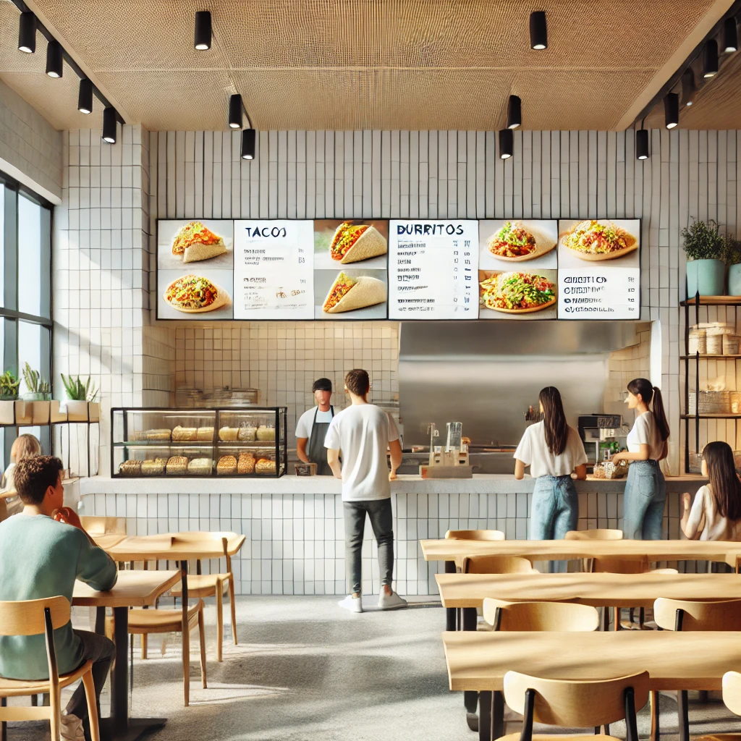
REACH Hub | Business plan
Example business plan
Throughout the rest of this presentation, we will be outlining the content of each section of a business plan. We will provide general guidance, but also provide specific examples based upon a Latin American fast-casual restaurant, known as Plantain & Spice.
In this presentation, an outline of key sections / considerations is provided – in addition to example sample content for Plantain & Spice. However, we note that this content is a shorter and simpler version of a business plan meant for illustrative purposes.

Slide 14
REACH Hub | Business plan
Executive summary
As a summary, the executive summary should attempt to provide 1-2 key insights from each of the sections of the rest of the business plan: ask yourself, what are the 10-15 most important things to know about the business and its proposed future? Often, these are key points from a business pitch – if it has already been prepared (see the Business Pitch module).
Executive summaries are a good place to showcase a well-crafted value proposition statement (see the Business Idea Sketch module).
For new businesses | For existing businesses
Emphasize the potential market opportunity and, if you are seeking investment, be sure to highlight factors that make your business sweet to investors (see the Business Idea Sketch module). | Be sure to highlight the ways in which your business has been successful and the people, activities, and resources that help it to stand out – even if the business is currently struggling, it will have important strengths to highlight.

Slide 15
REACH Hub | Business plan
Executive summary – sample content
Executive Summary
Plantain & Spice & a restaurant concept that helps those that love exploring new cuisines to save money and eat healthy by creating a fast-casual dining experience with a variety of Latin American cuisines – healthier than fast food and quicker than more expensive sit-down restaurants…
We plan to start our first restaurant in the West Adams neighborhood of Los Angeles, growing to three locations over the course of five years. We will offer an array of Latin American dishes including arepas, plantain bowls, and tacos…
Despite a number of fast-food and fast-casual competitors in the area, Plantain & Spice will offer a unique opportunity for multicultural community of West Adams to explore a wide range of ethnic cuisine options…
Founded by two experienced head chefs who have successfully launched successful fast-casual restaurants, Plantain & Spice aims to attract foot traffic with targeted social media and in-person outreach to local companies for catering…
When expanding to our second and third locations, we hope to centralize management and food preparation – providing an economy of scale to drive above average profit margins with each store breaking even within one year…
Plantain & Spice seeks $500,000 in funding and contact with a marketing agency specializing in helping fast-casual restaurants in our area…
Section
Business description
Products/services
Market/competitive analysis
Organization/ management
Marketing/sales strategy
Operations plan
Financial plans & projections
Funding request

Slide 16
REACH Hub | Business plan
Business description
The business description section sets the stage for a meaningfully detailed understanding of the business, it should at least include the following:
Expanded value proposition statement: Additional detail on who the customer is targeting and how value is being provided;
Basic characteristics: A more detailed description of the businesses – addressing key issues such as who is involved, what the business does, and where the business is located;
Future plan: Key goals/objectives for the business in the short and longer term;
Business form and ownership: Key facts about the business form and ownership (see the Business Creation module).
For new businesses | For existing businesses
This section might be shorter and emphasize future-oriented goals – or future expectations such as the business registering as an LLC/c-corporation (see the Business Creation module). | This section might be longer and go into greater depth helping to highlight the business’ strengths; in particular, this section might include a backward-looking timeline / set of milestones that the business has already reached (e.g., multiple locations, numbers of employees, annual revenue, etc.)

Slide 17
REACH Hub | Business plan
Business description – sample content
Business Description
Plantain & Spice is a fast-casual restaurant concept that targets the market of people who love exploring new cuisines and helps them to save money and eat healthy by creating a fast-casual dining experience with a variety of Latin American cuisines. To support healthy dining, the business will seek to maximize fresh and organic ingredients. To maintain a great deal of variety, the restaurant will have a variety of season offerings – helping to maintain its competitive advantage beyond other fast-casual restaurants that have more limited offerings…
The first location of Plantain & Spice will be in West Adams, a historic and culturally diverse community in the city of Los Angeles. Recently the neighborhood has seen an influx of small businesses and artistic endeavors…
Our key goals are as follows:
Within one year of operation; we will have our first location break-even and will aim for an overall 70% gross margin on our offerings by emphasizing corporate catering events;
Within three yeas, we hope to open three different locations across Los Angeles and we hope to reach an overall EBITDA margin of 30% by creating an economy of scale for food preparation and management;
Within three years, we hope to be promoted by a major newspaper or magazine as a leading restaurant for our healthy yet authentic options…
The business will be established as a c-corporation and it will be initially owned 33% by each of the three co-founders…
Consideration
Additional detail on a business’ value proposition statement
Relatively detailed description of the business – including the who, what, and where
Key goals and objectives for the business
Key facts about the business and its ownership

Slide 18
REACH Hub | Business plan
Products/services
This section provides an opportunity to dive deeply into what a company sells, be sure to:
Revenue streams: Outline the revenue streams of the product or services provided (see the Business Idea Pitch module);
Products/service types: Provide insight into the characteristics and production of key groups of products and services – and if applicable where the materials or resources are sourced from (this is also outlined in the Business Idea Pitch module);
Proprietary technology/information: Focus in on any proprietary technology or approaches to making your products/services unique – this could include a description of any intellectual property protections you have or hope to implement (trademarks, copyrights, patents, and trade secrets);
Research & development: In addition to already proposed/existing products and services, it is important to outline your approach to create new products/services via research and development.
For new businesses | For existing businesses
Emphasize the rationale behind the set of products and services offered and focus more time on how those products/services will meet customer needs and will be effectively marketed to customers. | An existing business will have greater detail to provide about the nature of existing products/services and can usefully provide evidence of the adoption and sales rates of different products and explain the unique appeal. However, if the business hopes to change in the future via research and development.

Slide 19
REACH Hub | Business plan
Products/services – sample content
Products and services
Plantain & Spice will have at least three distinct revenue streams: its in-store sales, delivery options, and catering events – with a focus on catering to corporations…
For in-store sales, we will offer the following major products: arepas, tacos, and plantain bowls. Variety will be provided by a number of customizable a-la-carte options including salsas, fresh fruit, ceviche, tamales, and empanadas. As a way to keep our margins low, but also emphasize healthy options, we will source key ingredients from non-corporate food service companies. For example, ingredients like the tomatoes, guacamole, and cilantro for salsa, garnishes, and guacamole, will be purchased from nearby small-scale organic farms…
Our proprietary technologies will be the ingredients of our empanadas – relying up a recipe passed down through generations from one of our founds and head chefs. To protect this recipe as a trade secret, the recipe will only be shared with key employees who will also sign non-disclosure agreements…
To help to provide additional ongoing variety in our products, our head chefs will develop new seasonal offerings that are based not only on seasonal customer preferences (like pumpkin-based options in the Autumn), but also new and emerging trends in the countries of origin for our three chefs. These chefs will build and maintain relationships with leading chefs in their countries of origin to monitor and then test the adoption of new menu options…
Consideration
Outline of revenue streams and drivers
Characteristics and production of products/services;
Focus on any proprietary technologies;
Discussion of research and development efforts.

Slide 20
REACH Hub | Business plan
Market/competitive analysis
This section provides an opportunity to understand the businesses’ market, industry, and key competitors.
Market characteristics: by market, we mean the “target” population (target market) of customers that the business hopes to sell to; an understanding of who these customers are is provided by a customer profile (see the Business Idea Sketch module), factors to highlight include he basic characteristics (both demographic and psychological) for one or more target markets, in addition to the size (number of persons), spending patterns, and rate of growth/decline in your target market.
Industrial characteristics: by industry, we mean the set of companies that are broadly related to one another in that they are involved with a type of product or service (for example the fast-casual restaurant industry), factor to highlight include:
Current size and growth trends, these estimates can usefully align with the total available market and serviceable available market figures estimated in the Business Pitch module;
Consumer trends regarding what is being values and purchased in relation to the products and services of the industry;
Typical dynamics within the industry that facilitate an understanding of your company’s business model (either by comparing or contrasting from these dynamics), including for example typical supply chain dynamics, typical profit margins (see the Financial Statements module);
Key opportunities and threats to the industry and your business – including new technologies, potential problematic/helpful regulations, societal/cultural patterns, and the nature of competition (for example, many similar smaller competitors or one large competitor, etc.).
Key competitor characteristics: by key competitors we mean those competitors that are most likely to provide similar or superior value propositions to your company – even if those companies are not superficially similar to yours. A useful starting point for consideration of key competitor characteristics relative to your value proposition is the competitor comparison developed in the Business Idea Sketch module.

Slide 21
REACH Hub | Business plan
Market/competitive analysis
This section provides an opportunity to understand the businesses’ market, industry, and key competitors.
Market characteristics: by market, we mean the “target” population (target market) of customers that the business hopes to sell to; an understanding of who these customers are is provided by a customer profile (see the Business Idea Sketch module), factors to highlight include he basic characteristics (both demographic and psychological) for one or more target markets, in addition to the size (number of persons), spending patterns, and rate of growth/decline in your target market.
Industrial characteristics: by industry, we mean the set of companies that are broadly related to one another in that they are involved with a type of product or service (for example the fast-casual restaurant industry), factor to highlight include:
Current size and growth trends, these estimates can usefully align with the total available market and serviceable available market figures estimated in the Business Pitch module;
Consumer trends regarding what is being values and purchased in relation to the products and services of the industry;
Typical dynamics within the industry that facilitate an understanding of your company’s business model (either by comparing or contrasting from these dynamics), including for example typical supply chain dynamics, typical profit margins (see the Financial Statements module);
Key opportunities and threats to the industry and your business – including new technologies, potential problematic/helpful regulations, societal/cultural patterns, and the nature of competition (for example, many similar smaller competitors or one large competitor, etc.).
Key competitor characteristics: by key competitors we mean those competitors that are most likely to provide similar or superior value propositions to your company – even if those companies are not superficially similar to yours. A useful starting point for consideration of key competitor characteristics relative to your value proposition is the competitor comparison developed in the Business Idea Sketch module.
Don’t be unrealistic!
Many entrepreneurs make the mistake of over-estimating the size of their market. This is not only potentially dangerous for financial projections which are based upon these estimates, but experienced lenders, investors, and partners will quickly see these unrealistic figures as a warning sign for potential over-optimism or a lack of caution/discernment on behalf of the entrepreneur.

Slide 22
REACH Hub | Business plan
Market/competitive analysis – sample content
Market/competitive analysis
Plantain & Spice’s target market are individuals who are looking to save money and explore a variety of culinary options while getting a fast meal. Our target market will likely be the 113,240 persons aged 16-65 living within five miles of the West Adams neighborhood of Los Angeles, or who commute to this neighborhood for work. In addition, there are an estimated 2,000 businesses within the area that might benefit from catering from Plantain & Spice. Having a sizeable target market is important given that this demographic is growing relatively slowing in comparison to past decades at a rate of 0.2% per year…
The fast-casual restaurant industry is valued at approximately $150 billion and is projected to grow at a rate of around 10% annually. This compares favorably to the growth rate of 2.1% for full-service restaurants…
Within the fast-casual restaurant industry, the average gross revenue per location ranges between $1-$3 million; in addition, gross margins within this industry gross profit margins range from 60-70%...
Within the industry, a major opportunity is the growing adoption of healthy eating patterns – as an example, based on a survey by McKinsey, at least 70% of people want to have more healthy diets; in contrast, a key threat to the continued growth of the industry is the rising cost of supplies and transportation…
Key competitors are of at least three types: fast-food restaurants that offer Latin American cuisine, other fast-casual restaurants with a healthy focus, and full-service restaurants that offer Latin American cuisine… A dominant competitor in this space is Chipotle, which holds an estimated 10% of market share within the fast-casual industry making this company a key competitor…
Consideration
Target market characteristics
Industrial size and growth trends
Typical industrial dynamics
Key opportunities and threats
Key competitor dynamics

Slide 23
REACH Hub | Business plan
Organization/management
This section provides an opportunity to go deeper into the proposed, or existing, nature of the organization’s ownership and management. In particular, it would be important to include mention and discussion of:
Ownership and legal structure: Describe the existing and/or intended legal structure of your business (see the Business Creation module) and profile the owners and their respective stakes in the organization.
Leadership: Including and potentially beyond the business owners, describe key leaders – or leadership positions that still need to be filled; often, an organizational chart is a useful way to illustrate lines of authority and domains of responsibility; this section is also a good place to provide more in-depth insight into the background of the leadership team (see the Business Pitch module for an example of what to highlight).
Key team members: Beyond the organization’s leadership, describe key team members (e.g., technical or marketing experts) or if those positions are unfilled, the responsibilities of those roles.
Any advisors or board members: List any formal or informal advisors that the organization will, or has, a relationship with – especially if the organization will, or will have, board members;
Key approaches to human resource management: Detail important and unique aspects to the organization’s human-resource management, that is, how it recruits, selects, onboards, trains (helps employees to gain key skills), develops (helps employees to transition from one role to another), rewards (in terms of pay and benefits), and evaluates employees (for example, annual/weekly performance reviews).
Key partners: Describe key partners that the organization will rely upon – especially those partners that have less to do with logistics and production, and more to do with the operation of the organization itself, including but not limited to accountants, attorneys, and marketing consultants.
Have a team for the business you want, not the business you have
It is important to understand, build a team with, or have a plan to get, the skills required not for your business in the immediate term (next 3-6 months), but for the longer-term (6 months to 3 years) into the future. Lenders and investors will want to see a balance of skills that are both currently required and will be needed to ensure that the business can continue to grow into the future.
For existing businesses
If an existing business is looking to grow or change in a meaningful way, it is often good to provide multiple organizational charts (current vs. future) to show how this change will influence organization/management.

Slide 24
REACH Hub | Business plan
Organization/management – sample content
Organization/management
Plantain & Spice is currently registered as an LLC in California, but within the next month, it will be registered as a C-corporation. Ownership of the company will be split equally among its two co-founders…
Beyond its two founders, key leadership will include a kitchen leader who will be recruited in the coming months. Our co-founders are Adriana Alonso and Brian Blanco. Adriana is originally from the Dominican Republic and was a head chef and then manager at Chipotle over the past five years. Brian Blanco, originally from Venezuela, was head chef and manager of a local fast-casual taqueria chain in California over the past three years…
Beyond Adriana, Brian, and their kitchen leader, key team members will include a service leader who will help to oversee the non-cooking staff… The service leader will need to have experience interviewing and training staff given a likely high level of turnover in this position…
Plantain & Spice hopes to secure three board members who are also investors in the business – hopefully with prior background in the fast-casual industry…
To help ensure above-average retention of line staff (food preparer, dishwasher, and customer service workers), we will provide a salary 20% above minimum wage, helping to ensure higher customer service through well-trained personnel…
Key partners for the business will include a local professional services firm, Small Business Plus, that will provide both legal and accounting support to the business; importantly, this partner will also recommend a real estate agency to help select the initial and subsequent locations for Plantain & Spice…
Consideration
Ownership/legal structure
Leadership
Key team members
Key advisors or board members
Key approaches to human resources
Key partners

Slide 25
REACH Hub | Business plan
Operations plan
An operations plan section of a business plan helps to provide a variety of key details about the business on a day-to-day basis. All of these details help to lead to an understanding, highlighted toward the end, of key risks in the operation of the business – and how those risks will be mitigated.
Business processes: This sub-section can be broken down into a discussion of key considerations in all important business processes that have not been otherwise discussed in the business plan (see the Business Idea Sketch module), including: logistics and procurement, production/processing, outbound logistics, and sales and support.
Operational milestones and metrics: Beyond key financial metrics of performance/success, this sub-section provides an opportunity to mention any milestones or metrics relating to the above processes that will provide evidence of the businesses’ growth, operational efficiency, and success;
Key technology/resources: In addition to any proprietary information/technology/resources mentioned in the product/services section, there is an opportunity to highlight any key technologies or resources that plan a particularly important role in business operations;
Compliance and regulatory issues: Depending on the businesses’ industry, there might be a several important compliance and regulatory issues to note – in addition to normal business operations permits and regulations;
Risk management: Building upon and referencing factors above, this section should emphasize the operational risks that your business faces (things that could go wrong) and what you as an entrepreneur have or are preparing to do reduce the risk and impact of such risks.
For existing businesses
For existing businesses, each sub-section should both review what has been done in the past, and where appropriate due to planned growth and change, highlight the ways in which the operations plan will change. In particular, it will be important to illustrate how the business has handled risks in the past and how it hopes to improve dealing with such risks in the future.

Slide 26
REACH Hub | Business plan
Operations plan – sample content
Operations plan
Plantain & Spice’s plan for successful operation emphasizes efficiency in its logistics and quick but safe food processing. Outbound logistics for delivery will be outsourced to one or more delivery apps…
Important operational milestones for the business will be the speed of its food preparation prior to the businesses’ daily opening. We hope to complete all food preparation within three hours using two employees by the end of our first year of operation – helping to cut costs and streamline operation. This will be achieved by ensuring on time food delivery, efficient storage, and a careful and thoughtful kitchen process…
Key technology for the restaurant’s smooth operation is its POS system that will facilitate ease of operation at the front and back of the restaurant. In addition, the restaurant will require the careful maintenance of its largest and most important capital equipment – its industrial grill and ventilation hood…
As a high-volume restaurant, food safety is a predominate concern and compliance with both local food safety rules, but also even more stringent industry standards will be adhered to.
Key risks in the fast-casual industry relate mostly to the potential for food contamination. In particular, key food contamination risks relate to the preparation of avocados and chicken. The business will adopt cutting-edge standards to help ensure the spread of food-born contamination by blanching avocados and two layers of cleaning protection when chicken is being cooked. These practices have been adopted by Chipotle, a key competitor, in the wake of widespread food-born contamination.
Consideration
Business Processes
Operational milestones
Key technology/ resources
Compliance and regulatory issues
Risk management

Slide 27
REACH Hub | Business plan
Financial plans & projections
The financial plans & projections section of a business plan is an opportunity to introduce readers to the basis for the future financial performance of the business. This section introduces and discusses key aspects of the supporting financial statements (income statement, balance sheet, and cash-flow statement) that will be placed in the appendix. A detailed handling of financial statements and associated financial ratios and analysis is provided in the Financial Statement module. The financial plans & projection section of the business plan provides the financial detail of the intended goals of the business from the business description section.
Financial history and/or projections: It will be important to estimate past and/or future profitability through revenue and cost projections (note: the basis of these projections can be the sort of break-even analysis detailed in the Business Pitch module). Ideally, projections will be combined with projections under different scenarios and a projected cash-flow statement – as explained in the Financial Statement module; key insights that might be gleaned from this history and/or projections include the break-even point of a business and key expenses for the business.
Key financial ratios (projections and/or existing): This is an opportunity to showcase how the business can grow, and the potential attractiveness of the business to lenders and/or from investors by referencing key financial ratios (financial ratios are discussed in the Financial Statement module) – ideally these numbers should be presented with context as to what is typical/expected in the businesses’ industry.
For new businesses | For existing businesses
For new businesses, it will be important to provide evidence for the possibility of the projected growth that is discussed in this section; forms of evidence for such growth are introduced in the Business Pitch presentation and dealt with in greater depth in Entrepreneurial Mindset Training via a focus on experiments. | For existing businesses, it will be important to both review past financial performance and then introduce projected future performance. Existing businesses have the opportunity to highlight key financial ratios from past performance that support the likelihood of future financial success. In addition to the above, it will be important for existing businesses to present a balance sheet and to discuss key insights from this balance sheet, including relevant ratios including, for example, return on asset ratio, a current/quick ratio, and debt to equity ratio.

Slide 28
REACH Hub | Business plan
Financial plans & projections
The financial plans & projections section of a business plan is an opportunity to introduce readers to the basis for the future financial performance of the business. This section introduces and discusses key aspects of the supporting financial statements (income statement, balance sheet, and cash-flow statement) that will be placed in the appendix. A detailed handling of financial statements and associated financial ratios and analysis is provided in the Financial Statement module. The financial plans & projection section of the business plan provides the financial detail of the intended goals of the business from the business description section.
Financial history and/or projections: It will be important to estimate past and/or future profitability through revenue and cost projections (note: the basis of these projections can be the sort of break-even analysis detailed in the Business Pitch module). Ideally, projections will be combined with projections under different scenarios and a projected cash-flow statement – as explained in the Financial Statement module; key insights that might be gleaned from this history and/or projections include the break-even point of a business and key expenses for the business.
Key financial ratios (projections and/or existing): This is an opportunity to showcase how the business can grow, and the potential attractiveness of the business to lenders and/or from investors by referencing key financial ratios (financial ratios are discussed in the Financial Statement module) – ideally these numbers should be presented with context as to what is typical/expected in the businesses’ industry.
Do not underestimate expenses
Just like it is important to not overestimate one’s market (and associated revenue), it is important to not underestimate one’s expenses. It is often a good idea to expect financial setbacks – and to reflect that planning in one’s financial plans and projections.
For new businesses | For existing businesses
For new businesses, it will be important to provide evidence for the possibility of the projected growth that is discussed in this section; forms of evidence for such growth are introduced in the Business Pitch presentation and dealt with in greater depth in Entrepreneurial Mindset Training via a focus on experiments. | For existing businesses, it will be important to both review past financial performance and then introduce projected future performance. Existing businesses have the opportunity to highlight key financial ratios from past performance that support the likelihood of future financial success. In addition to the above, it will be important for existing businesses to present a balance sheet and to discuss key insights from this balance sheet, including relevant ratios including, for example, return on asset ratio, a current/quick ratio, and debt to equity ratio.

Slide 29
REACH Hub | Business plan
Financial plans & projections – sample content
For new/existing businesses
For existing businesses
Financial projections
Plantain & Spice hopes to in its first year generate $1.5 million in revenue with a gross margin of 50% and $600,000 in fixed costs annually.
To earn $1.5 million annually, we expect to make 35,000 in-store orders, 25,000 delivery orders, and 250 catering events…
Major fixed costs include:
Rent of approximately $80,000 annually;
An annual marketing budget of $50,000;
Insurance of $20,000 annually;
Walk-in freezer of $15,000;
Commercial oven of $15,000.
Based on the above estimates, we project to earn $50,000 in earning before interest taxes, depreciation, and amortization.
The owners of Plantain & Spice will plan to invest $100,000 of their own money into the business.
Financial summary
As seen in the income statement in the Appendix, the first location of Plantain & Spice has generated $1.5 million in revenue with a gross margin of 50% and $588,000 in fixed costs over the past year. In comparison to our projections one year ago, we have been able to keep our fixed costs 10% below projections. This has led to a net profit margin of 10%...
As detailed in the cash flow statement summary in the appendix, Plantain & Spice had an ending cash balance of $207,500 with a net change in cash of $107,500 from the $100,000 beginning cash balance from the owner’s initial investment…
As explained in our balance sheet in the appendix, from our first year in operations, we hold $250,000 in equity with $50,000 in retained earnings and our initial owner’s investment of $100,000. We hold an acceptable debt-to-equity ratio of 1.04 and both a favorable current ratio of 1.41 and a debt service coverage ratio of 7.5…

Slide 30
REACH Hub | Business plan
Funding request
Within a business plan that seeks funding for lenders or investors, the funding request page helps to make the case for why the business needs money, the type of funding the business is seeking, and the desired or acceptable terms for that funding. The factors to be included differ based upon the type of funding sought – namely whether the funding sought is predominately debt-based, equity-based, or both. However, regardless as to the source, it is important to mention:
The specific funding amount needed: this estimate should come from financial projections – a topic considered in the Business Pitch module – with reference to when certain amounts of funding are required;
Use of funds: A detailed breakdown of the use of the funds, both in general (whether the funds will go to startup costs, operating capital, marketing, debt repayment, etc.), but then also with an explanation as to what major expenses those funds will go toward within those categories.
Existing funding: A mention of any existing funding already provided (including by the owners), and what terms or obligations that funding is tied to.
For debt-based funding | For equity-based funding
Debt-based funding is covered in greater depth within the Debt Funding module. It will be important to specify your desired terms, including: Loan duration; Interest rate; and Repayment schedule. | Equity-based funding is covered in greater depth within the Equity Funding module. Amount of equity investment needed; Pre-money valuation of the business; Expected return on investment (ROI); Exit strategies for investors and owners; Type of equity offered: common vs. preferred shares and proposed voting rights, dividends, and control over business decisions; Investor involvement expectations/rights post-investment (for example, seats on the board of directors and whether the business hopes for certain added value from investors like expertise, activism, and support for further fundraising).

Slide 31
REACH Hub | Business plan
Appendix
A wide range of supporting documents can and should be provided in an appendix whenever there are likely to be questions raised by certain readers about key aspects of a business that can only be answered by highly detailed or credible documentation (e.g., financial statements and tax documents). Documents that are likely to be included in a business plan appendix include the following. We detail documents likely required in any business plan, and then focus on additional documentation that is likely to be required if the business is seeking funding from those reading/reviewing the business plan.
Resumes of key management/owners;
Additional information (pictures, videos, detailed descriptions, specifications) of products/services;
Market research data – ideally with detailed charts, graphs, and tables;
Detailed financial statements, including:
Income statement;
Balance sheet;
Cash flow statements;
Legal documents, including:
Business licenses;
Permits;
Intellectual property documentation, including: patents, trademarks, and copyrights;
Contracts, including:
Partnership agreements;
Lease agreements;
Key contracts with suppliers and customers.
References and letters of support.
For funding:
Financial projections for the next 3-5 years, including a break-even analysis and pro-forma income statement and cash flow analysis
For debt-based funding:
Loan amortization schedule;
Personal financial statement;
For equity-based funding:
Existing ownership and equity structure (capitalization table);
Term sheet.

Slide 32
REACH Hub | Business plan
Overview
What is a business plan and what is it used for?
Parts of a business plan
Recommendations for writing a business plan
Summary
What’s next

Slide 33
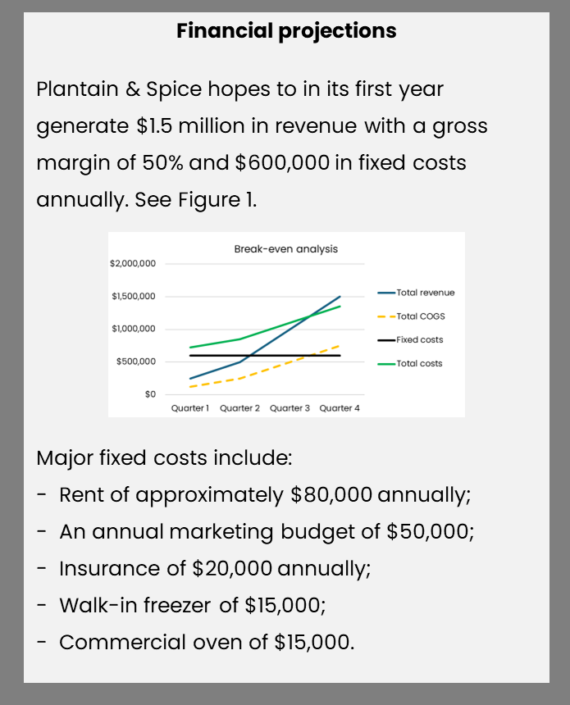
REACH Hub | Business plan
Writing a business plan
Despite the formatting of text within this presentation, it is best to present the business plan in a clear and easy to read manner. Supporting, this, be sure to:
Write in short simple sentences;
Use reading text sizes and spacing;
Include supporting images, tables, and charts;
Use bullet points when discussing a list of items.
Bad example of formatting
Good example of formatting

Slide 34
REACH Hub | Business plan
Writing a business plan
Overall, outside of the appendix, a short business plan is likely 15-20 pages (3,500 – 5,000 words) while a more detailed business plan is 20-40 pages (5,000-10,000 words); however, depending on complexity, some business plans might be much longer.
Part | Typical length
Executive summary | 1-2 pages (300-600 words)
Business description | 1-2 pages (300-1,000 words)
Products/services | 1+ page (250 words) per product/service line
Market/competitive analysis | 2-5 pages (600-1,000 words)
Organization/management | 1-2 pages (300-500 words)
Marketing/sales strategy | 2-5 pages (600-1,000 words)
Operations plan | 2-5 pages (600-1,000 words)
Financial plans & projections | 2-5 pages (600-1,000 words)
Funding request | 1 page (300-500 words)
Appendix | Various – may include 5-20+ exhibits, documents, figures, tables, etc.

Slide 35
REACH Hub | Business plan
Overview
What is a business plan and what is it used for?
Parts of a business plan
Recommendations for writing a business plan
Summary
What’s next

Slide 36
REACH Hub | Business plan
Summary
Business plans are a useful next step after having developed a business idea sketch, and possibly also after having developed a business pitch – they help to summarize the future of a business in relatively great detail;
Business plans have typical structures with certain sections, including the following:
Executive summary
Business description
Products/services
Market/competitive analysis
Organization/management
Marketing/sales strategy
Operations plan
Financial plans & projections
Funding request
Appendix
Thinking about how to present a business plan is also critical and the document should be easy to read with useful graphics and avoiding of large text blocks when possible.

Slide 37
REACH Hub | Business plan
Overview
What is a business plan and what is it used for?
Parts of a business plan
Recommendations for writing a business plan
Summary
What’s next

Slide 38
REACH Hub | Business plan
Equity-based
investment
Debt- and other financing
Introduction to financing
ESOPs
Contracts
Financial management
Accounting basics: tax & audits
Making it official & attorneys
Business plan
Basics of bookkeeping
Business pitch
Business idea sketch

Slide 39
REACH Hub | Business plan
Equity-based
investment
Debt- and other financing
Introduction to financing
ESOPs
Next steps
After engaging with this presentation on business plans, a good next step is reviewing material on Financial Management and then issues contained in the presentation on Making it Official & Attorneys.
Contracts
Financial management
Accounting basics: tax & audits
Making it official & attorneys
Business plan
Basics of bookkeeping
Business pitch
Business idea sketch

