Slide 1
Business
pitch
REACH Hub
Resources for Entrepreneurship Advising & Coaching

Slide 2
REACH Hub | Business pitch
Our approach
Throughout the REACH Hub, we aim to ensure that resources SPEAK, that is, that they are:
Simple – clear and without unnecessarily complication
Psychological – focused on helping entrepreneurs think effectively
Empowering – centered on SEDI populations
Aligned – relevant to and linked with other approaches
Knowledge-based – built on research-based insights

Slide 3
REACH Hub | Business pitch
Our approach
Throughout the REACH Hub, we aim to ensure that resources SPEAK, that is, that they are:
Simple – clear and without unnecessarily complication
Psychological – focused on helping entrepreneurs think effectively
Empowering – centered on SEDI populations
Aligned – relevant to and linked with other approaches
Knowledge-based – built on research-based insights
Helpful call-outs
Throughout this presentation, there are special slides that provide additional information. They are indicated by transparent grey backgrounds like this one.
Mindset: this logo indicates that the call-out is related to an entrepreneurial mindset – a topic covered in the Reach Hub’s Entrepreneurial Mindset Training
Coach/advisor tip: this logo indicates that the call-out is related to advice designed for a coach or advisor who is working with a small business or entrepreneur
Links are underlined
This presentation includes links to other resources in the REACH Hub indicated by underlined text

Slide 4
REACH Hub | Business pitch
Purpose
The purpose of this presentation is to provide you an introduction to business pitches – both their uses and the information that goes in them. Building a pitch deck is often the next step following putting together a business idea sketch, and is an important step before an entrepreneur begins to informally introduce others to their business idea. As seen on the next slide, this presentation is useful to review after the Business Idea Sketch presentation.
Disclaimer:
The information provided in this content does not, and is not intended to, constitute: legal advice, accounting, tax, financial advice, an offer to buy or sell securities, nor is it intended as financial or investment advice; instead, all information, content, and materials available in this content are for general educational purposes only. Information in this content may not constitute the most up-to-date legal, financial, accounting, financial, or investment information. The content may contain links to other third-party websites and to content generated by third parties. Such links and content are only for the convenience of the user; the authors of this content do not recommend or endorse the content of any third-party sites or content.

Slide 5
REACH Hub | Business pitch
Equity-based
investment
Debt- and other financing
Introduction to financing
ESOPs
Contracts
Financial management
Accounting basics: tax & audits
Making it official & attorneys
Business plan
Basics of bookkeeping
Business pitch
Business idea sketch

Slide 6
REACH Hub | Business pitch
Overview
What is a business pitch and what is it used for?
What is in a pitch deck?
How should entrepreneurs make presentations?
Summary
What’s next

Slide 7
REACH Hub | Business pitch
Overview
What is a business pitch and what is it used for?
What is in a pitch deck?
How should entrepreneurs make presentations?
Summary
What’s next

Slide 8
REACH Hub | Business pitch
Business pitch
A business pitch is a presentation of a new idea for a business, the future potential for an existing business, or the future potential of an addition/change to an existing business.
Business pitches are built upon “decks” (herein pitch decks) – a set of slides that are visually appealing and provide concise and clear information;
Pitches can be presented to different audiences.

Slide 9
REACH Hub | Business pitch
Uses of the business pitch
There are at least three purposes for pitches:
Type of use | Note
Feedback and iteration: clarifying a business idea for the entrepreneur and those they are working with | Pitch will often be made informally
Communication: communicate a vision for the future of a business to others including potential employees or partners | Pitch will often be sent via email to others or presented formally
Fundraising: attracting investment from potential investors – either debt-based or equity-based | Pitch will often be presented formally – or sent via email to others; when used in this way, the presentation might include additional text on its slides; when sent with a business plan, the pitch does not need extra text

Slide 10
REACH Hub | Business pitch
Overview
What is a business pitch and what is it used for?
What is in a pitch deck?
How should entrepreneurs make presentations?
Summary
What’s next

Slide 11
REACH Hub | Business pitch
What is in a pitch deck?
Typically, a pitch deck is a set of simple slides with limited text that an entrepreneur presents live to others – either in-person or virtually. Alternatively, a pitch deck can involve more detailed information and text if it is designed to be emailed or otherwise sent to others without a live presentation.
My business pitch

Slide 12
REACH Hub | Business pitch
Typical slides/sections in a business pitch
Introduction
Problem
Solution
Market opportunity
Product/service detail
Revenue model
Market validation / traction
Go-to-market strategy
Competitive landscape
Financial projections
Overview of team
Investment needs & ask
Summary & vision
Typically, pitch decks are between 10-20 slides in length; sometimes, they also include an appendix with more detailed supporting information. Perhaps the most typical approach has the 13 slides represented to the left. In this presentation, we will introduce the content/information that goes on each slide.

Slide 13
REACH Hub | Business pitch
Pitch deck topics
Here we briefly introduce each of the pitch deck topics, and then go into greater depth into each one following the next slide.
1. Introduction | Brief overview of the business and its most important parts
2. Problem | Overview of the problem from customers’ standpoint
3. Solution | General introduction to how a business helps customers
4. Market opportunity | Preview of how big the business could grow in terms of revenue
5. Product/service detail | More detail on the businesses’ products/services
6. Revenue model | Insight into how the business makes money
7. Market validation / traction | Evidence of whether customers will buy your products/services
8. Go-to-market strategy | Plan to reach new customers
9. Competitive landscape | Explanation as to why the business is better than others
10. Financial projections | Detail on the idea’s potential to make a profit across time
11. Overview of team | Detail on who is involved and why they are the right people
12. Investment needs & ask | Mention of what money and resources the business needs
13. Summary & vision | Summary of key points and look to the future
Slide
Explanation

Slide 14
REACH Hub | Business pitch
Pitch decks are just more info on the 5 “S” framework
 | Solution | Superior | Sensible | Sustainable | Sweet
1. Introduction | X | X | X | X | X
2. Problem | X | X
3. Solution | X
4. Market opportunity |  |  |  | X
5. Product/service detail | X
6. Revenue model |  |  |  | X
7. Market validation / traction |  |  | X
8. Go-to-market strategy |  |  | X
9. Competitive landscape |  | X
10. Financial projections |  |  |  | X
11. Overview of team |  |  | X
12. Investment needs & ask |  |  |  |  | X
13. Summary & vision |  |  |  |  | X
While the topics of a typical pitch deck might seem complicated at first, pitch decks just build upon the 5 “S” framework from the business idea sketch – see the Business Idea Sketch module.
Slide

Slide 15
REACH Hub | Business pitch
White vs. Black Backgrounds
To most effectively present the information that goes in pitch decks, we will use two different types of slides for the rest of the presentation:
White backgrounds = information about what goes on a slide and how to get/prepare that information;
Black backgrounds = example of what a slide should look like when it is presented; the text that an entrepreneur might read when presenting the slide is presented in grey at the bottom.
Throughout this section of the presentation, we will be using the example of a fast-casual Latin American restaurant; this example builds upon an example business idea in the business idea sketch module.
Typical slides in a business pitch
Introduction
Problem
Solution
Market opportunity
Product/service detail
Revenue model
Market validation / traction
Go-to-market strategy
Competitive landscape
Financial projections
Overview of team
Investment needs & ask
Summary & vision
Typically, pitch decks are between 10-20 slides in length; sometimes, they also include an appendix with more detailed supporting information. Perhaps the most typical approach has the 13 slides represented to the left. In this presentation, we will introduce the content/information that goes on each slide.

Slide 16
REACH Hub | Business pitch
Slide 1: Introduction
Value proposition statement:
The introductory slide is a chance to provide a broad overview of your business idea – a useful tool to do this is your value proposition statement. Value proposition statements are discussed in the business idea sketch module. Often the presenter will just speak the value proposition statement.
Logo and name:
The introductory slide usually has the company’s name and/or logo. Think of a name a logo that is unique and memorable – uniqueness often comes from using new words. Be sure to research existing trademarks before settling on a business name or logo.
See the Patent and Trademark Office’s website.

Slide 17
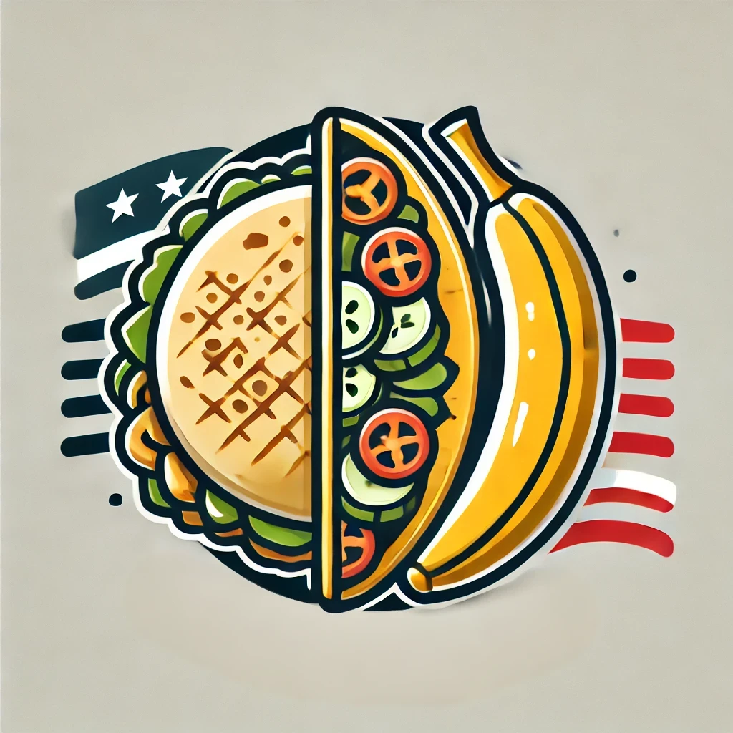
Plantain & Spice
Spoken text: Hi I’m the co-founder of Plaintain and Spice. We help those that love exploring new cuisines to save money and eat healthy, by creating a fast-casual dining experience with a variety of Latin American cuisines – healthier than fast food and quicker than more expensive sit-down restaurants.

Slide 18
REACH Hub | Business pitch
Slide 2: Problem
Focus on the problem from the standpoint of your customers:
An effective way to introduce the problem that your business is helping to solve is to revisit your customers’ profile(s) and to represent some of their key problems. The customer profile was introduce in the business idea sketch module.
It is often effective to represent or describe actual customers and either directly or indirectly mention how their problems are not being solved by your existing competitors.

Slide 19
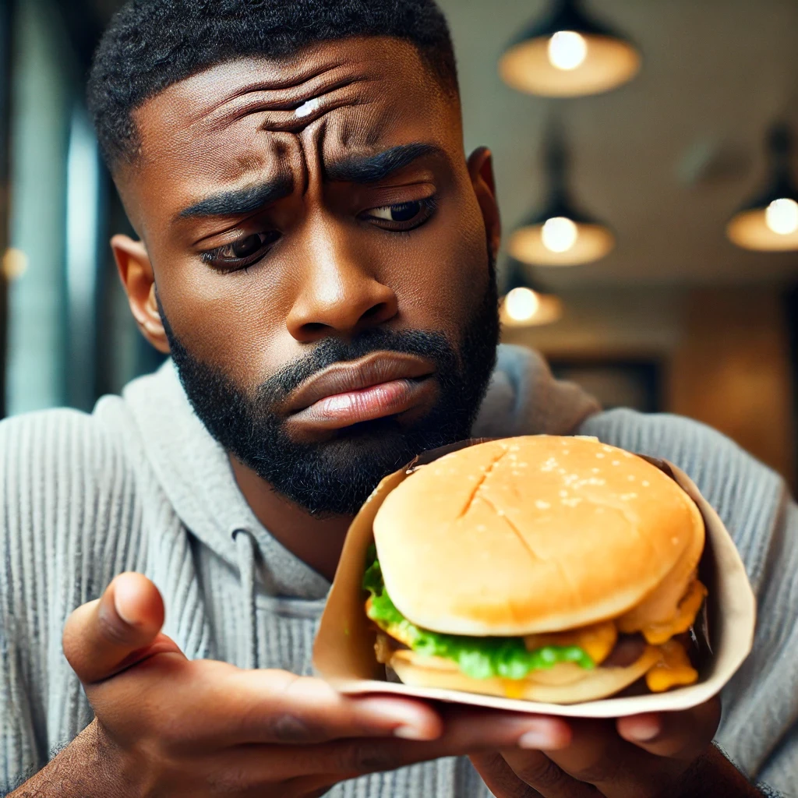
The problem
Spoken text: Busy people who love exploring new cuisines have a hard choice: eat unhealthy fast food, sit down at restaurants that take too long, or return to the same old fast casual restaurant.

Slide 20
REACH Hub | Business pitch
Slide 3: Solution
Provide information about the most important parts of your business idea:
A good way to focus on the most important parts of your business is to return to the dimensions that make your business superior to your competitors. These dimensions were focused on in the competitor comparison.
Solution slides should focus on just 3-5 key issues. Leaving details about products and services for a later slide.

Slide 21
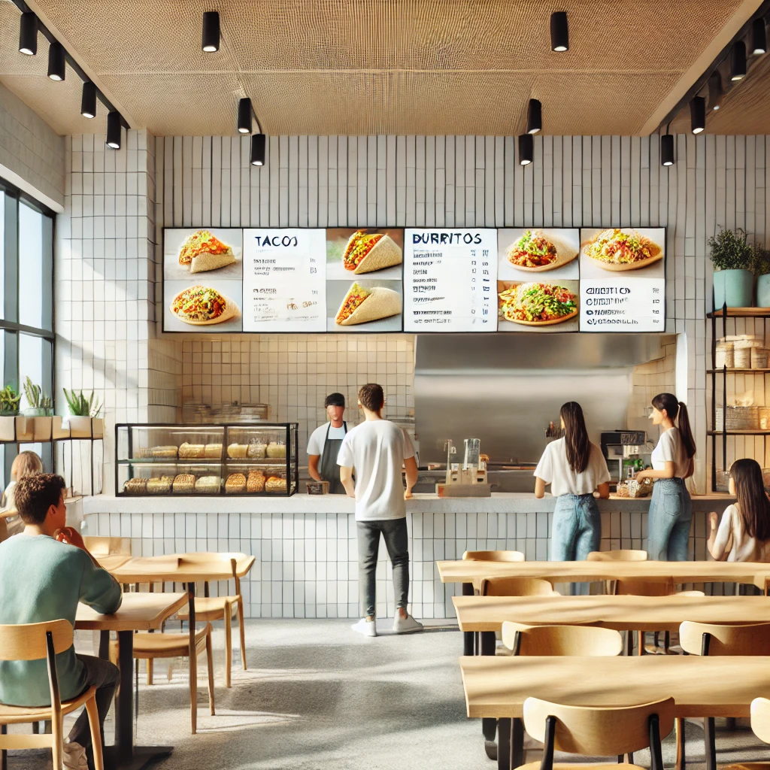
The solution: Plantain & Spice
Fast-casual pace
Moderate price
Variety of offerings – from several Latin American countries
Focus on health
Spoken text: Plantain and Spice will help diners like these to find their new favorite fast casual restaurant that allows them to save money, explore new and different cuisines from several Latin American countries, and a strong focus on health.

Slide 22
REACH Hub | Business pitch
Slide 4: Market opportunity
The size of market opportunities is measured by the potential future revenue of your business
Future revenue can be thought of in at least three different ways:
Total
available market (TAM);
Serviceable
available market (SAM);
Serviceable
obtainable market (SOM).
These concepts should ideally be reflected in $ values and the presenter should provide key underlying assumptions about where these numbers come from

Slide 23
REACH Hub | Business pitch
Slide 4: Market opportunity
TAM/SAM/SOM is typically most relevant for high-growth businesses
For businesses that hope to grow rapidly, the concepts of TAM and SAM are important indications of their market opportunity. However, these concepts might not be relevant to businesses that hope to grow only modestly or hope to merely “optimize” their profitability, by for example, lowering costs, offering limited new products/services, or reaching a slightly broader range of customers. In these cases, often SOM is the only relevant concept and the market opportunity for the business can just be presented as increasing somewhat in the short (3-5) or mid-term future (5+) years.
The size of market opportunities is measured by the potential future revenue of your business
Future revenue can be thought of in three different ways:
Total
available market (TAM);
Serviceable
available market (SAM);
Serviceable
obtainable market (SOM).
These concepts should be reflected in $ values and the presenter should provide key underlying assumptions about where these numbers come from.

Slide 24
REACH Hub | Business pitch
Concept | Helpful hint | Where does information about this concept come from? | Example for products that needs to be shipped or delivered in person | Example for an online services
TAM (Total Addressable Market): This is the overall revenue opportunity available if your company could successfully to all of your potential customers. | Think of this as your “dream” market – a long-term estimate of how big your business could potentially grow | Online research about the size of markets for different products/ services Speaking to a market research firm | Amount of money that could be made in a year by selling to people everywhere – either across the state, nationally, or internationally | Amount of money that could be made in a year by selling to many different types of people – not just those already interested in your type of service
SAM (Serviceable Available Market): This is a portion of TAM, this either represents the amount of revenue that could come from the geographic area your business could currently reach or the most obviously interested type of customer. | This estimate is the amount of money that the companies you compete against earn | Online research about the size of markets Online research about the revenue of your major competitors Speaking to a market research firm | Amount of money that could be made in a year by selling to people in your local region (city or state) | Amount of money that could be made in a year by selling to all of the customers that are already interested in buying a service like yours
SOM (Serviceable Obtainable Market): This is the portion of SAM that you can realistically capture in the shorter term given your competition and current resources. | This is a realistic estimate of what your business can earn within the next 5 years | Online research or in-person investigation about a competitor similar to you Your estimates of how much you could produce Speaking to a market research firm | Amount of money that could be made in a year by selling to people in the part of the city where you start selling | Amount of money that could be made in a year by selling to a share of the people that already are interested in a service like yours

Slide 25
REACH Hub | Business pitch
Slide 4: Market opportunity
Your serviceable obtainable market (SOM) is an important concept because it is an estimate of how much money your business is likely to early in the near- to mid-term (1-3 years). SOM should be less speculative than SAM or TAM.
Accurately estimating SOM should be done by using, and comparing the results of, three different approaches. This is known as “triangulation”. The three different approaches are:
More accurate estimate
Top-down approach
Yardstick approach
Bottom-up approach

Slide 26
REACH Hub | Business idea sketch
Top-down approach
A top-down approach to revenue estimation assumes that there is an existing market (group of customers) for your, or similar, products or services. The question is, within the time period being projected (often 3-5 years), what portion of this market (slice of the pie) can your business take?
For our Latin American restaurant, we might see, for example, that the total market (amount of money spent) on restaurants in our area is $100 million per year. If we know that there are 10 restaurants in the area, then we might assume we can take a similar share of the market than the average restaurant – an estimate of $10 million.
Where does this information come from?
Determining how big a market is requires doing secondary research on a number of factors, including but not limited to the total revenue of companies offering similar products/services and the number of potential or existing customers that could be targeted.

Slide 27
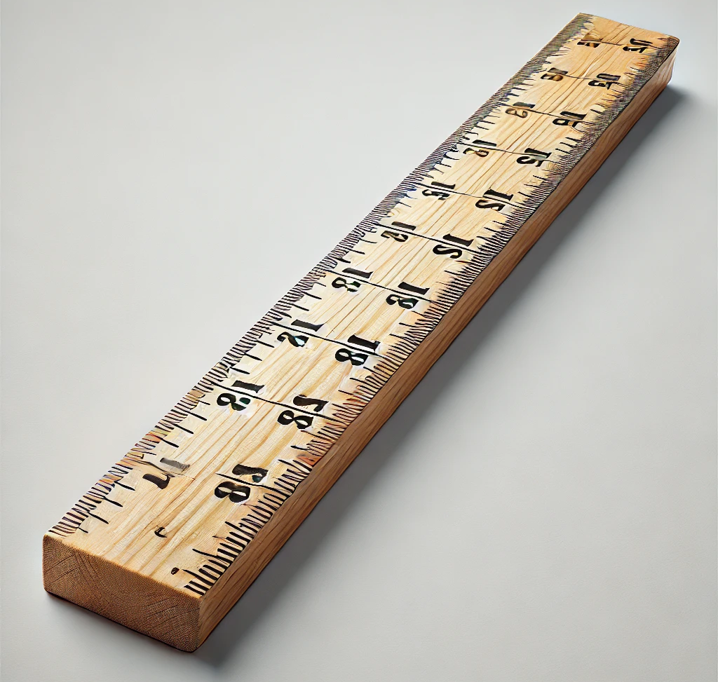
REACH Hub | Business idea sketch
Yardstick approach
A yardstick approach to revenue estimation assumes that to understand revenue, you should try and compare yourself to a similar company at a similar point of time in that company’s growth.
Where does this information come from?
Determining a similar company’s revenue will either require accessing secondary information (for public or large private organizations) or primary information directly collected from individuals with knowledge of smaller private companies.
For our Latin American restaurant, we observe that a similar restaurant in a similar area to ours was able to make $2 million annually in its third year.

Slide 28
REACH Hub | Business idea sketch
Bottom-up approach
A bottom-up approach to revenue estimation assumes that to understand revenue, you should work up from the most basic “building blocks” about how your business will operate. For example, how many units can you produce per day or how many customers could you serve per month?
Where does this information come from?
Bottom-up estimates of revenue often come from observations about basic parts of how a business operates. These estimates often assume that there will be unrestricted demand for a product/service and the limiting factor is how much can be produced/delivered.
For our Latin American restaurant, we might estimate that we could likely serve 150 customers per day. If each customer spent on average of $20, then, our daily revenue would be $3,000 – bringing our annual revenue to approximately $1 million.

Slide 29
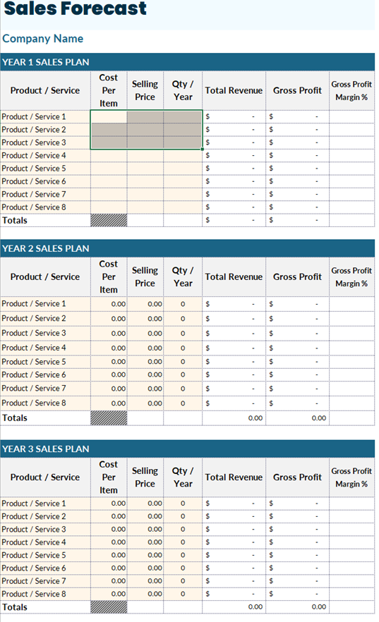
REACH Hub | Business idea sketch
SOM = Sales forecast
The estimates of SOM is equivalent to the sales forecast for your business, sales forecasting is supported by Financial Projections Template. In particular, we note that SOM (as well as SAM and TAM estimates) include the revenue from all of the business’ products and services. You can add up these projections across the firs three years in the template’s “Sales Forecast” tab.

Slide 30
REACH Hub | Business idea sketch
Top-down approach
$1.5 million
$10 million
More accurate estimate
$2 million
Yardstick approach
$1 million
For our Latin American restaurant, we would compare revenue estimates from all three approaches, and might decide to take an average or observe that two estimates align. In the present case, we might average the yardstick and bottom-up approach, discarding the top-down approach for an overall estimate of $1.5 million in revenue within the first few years.
Bottom-up approach

Slide 31
Market opportunity
$1.5 million from our first store
Competitors in Los Angeles
($50 million)
Fast-casual market
($125 billion)
Spoken text: Plantain and Spice is part of the large $125 billion fast-casual market in the United States – our total available market; within Los Angeles where we hope to begin operating, fast-casual restaurants like ours make approximately $150 million – our serviceable attainable market. Within the first three years, we hope to earn $1.5 million annually by opening and operating our first store – our serviceable obtainable market.

Slide 32
REACH Hub | Business pitch
Slide 5: Product/service detail
Important key details of your product/services
In this slide, key details about your products/services should be presented, these details should help listeners to understand the specific appeal of your business to customers – and will often involve providing information on the variety of products/services you offer

Slide 33
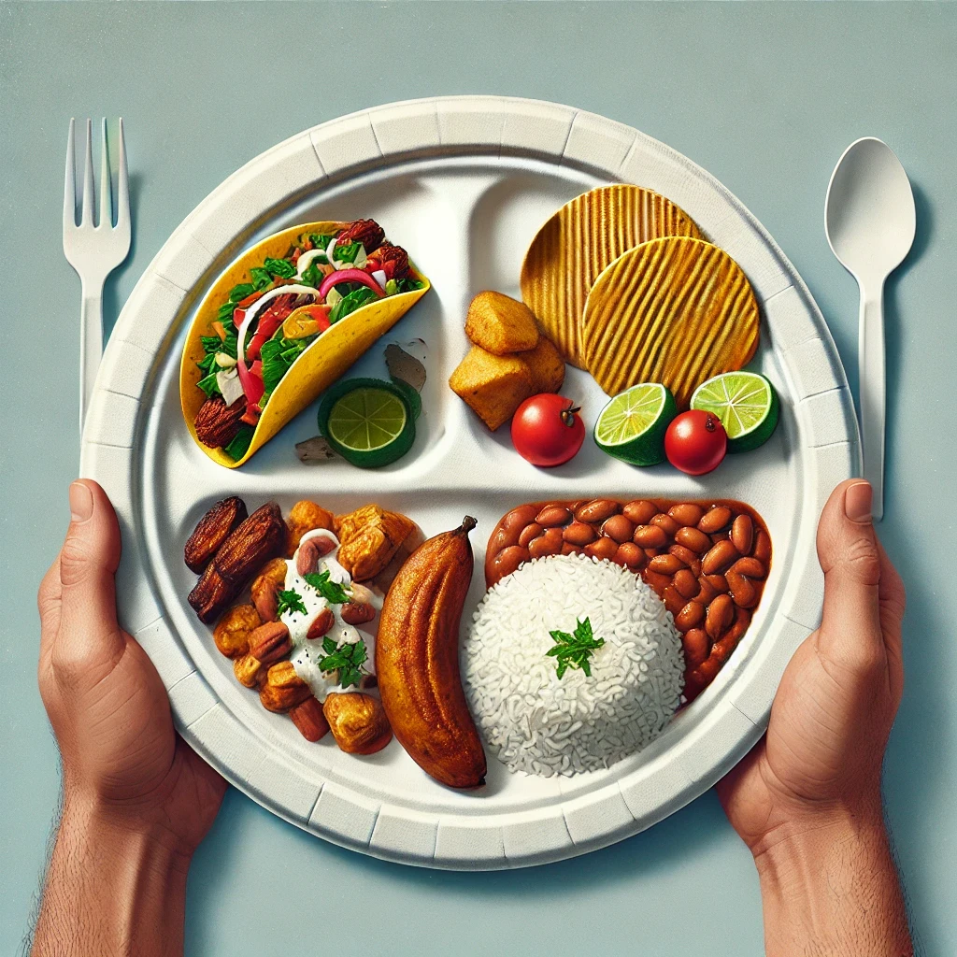
Our meals
Our meals will be moderately priced – from a $10 basic plate to a $30 full plate – with an average price of $20
Spoken text: Plantain and Spice will have a variety of offerings, form arepas and plantains to different types of tacos, beans, and rice. Customers will be able to buy a small and simple “basic plate” for $10 to a “full plate” with multiple offerings for $30. The average price of our plates will be $20.

Slide 34
REACH Hub | Business pitch
Slide 6: Revenue model
A revenue model is the way that a business makes money; a model combines different revenue streams and revenue drivers.
Revenue drivers
Successful businesses often have multiple different ways to “drive” revenue – examples are provided on the next slide. Having multiple revenue drivers helps to make a business attractive (sweet) to investors – see the business idea sketch module.
Revenue streams
A revenue stream is the type of way that you hope to make money – this might not just be the sales of your product or service. These include:
Selling products/services;
Advertising;
Subscriptions;
Renting products/services;
Licensing the right to use content or information.

Slide 35
REACH Hub | Business pitch
Revenue drivers
Major revenue drivers include the following
Revenue driver | Definition
Large profit margin | Selling products and services at a high profit margin (see the income statement module)
Sales volume | Selling a large number of your products/services
Repeat customers | Ways that help customers to keep coming back to you – instead of having to get new customers
Variety of offerings | Having a variety of sometimes very different products/services to sell to customers
Upselling | Having ways that customers can increase the value of your products services (premium versions)

Slide 36
REACH Hub | Business pitch
Revenue drivers
Major revenue drivers include the following
The more the better!
When new or existing businesses struggle, it is often because they are simply not generating a sufficient amount of revenue. Having more revenue streams and more revenue drivers for those streams helps to ensure that if one stream of revenue is not sufficient, that others will help to make up the difference. It is often helpful to push entrepreneurs to think of creative approaches to adding new and additional lines of revenue and revenue drivers. This issue is covered in greater depth in the Entrepreneurial Mindset Training.
Revenue driver | Definition
Large profit margin | Selling products and services at a high profit margin (see the income statement module)
Sales volume | Selling a large number of your products/services
Repeat customers | Ways that help customers to keep coming back to you – instead of having to get new customers
Variety of offerings | Having a variety of sometimes very different products/services to sell to customers
Upselling | Having ways that customers can increase the value of your products services (premium versions)

Slide 37
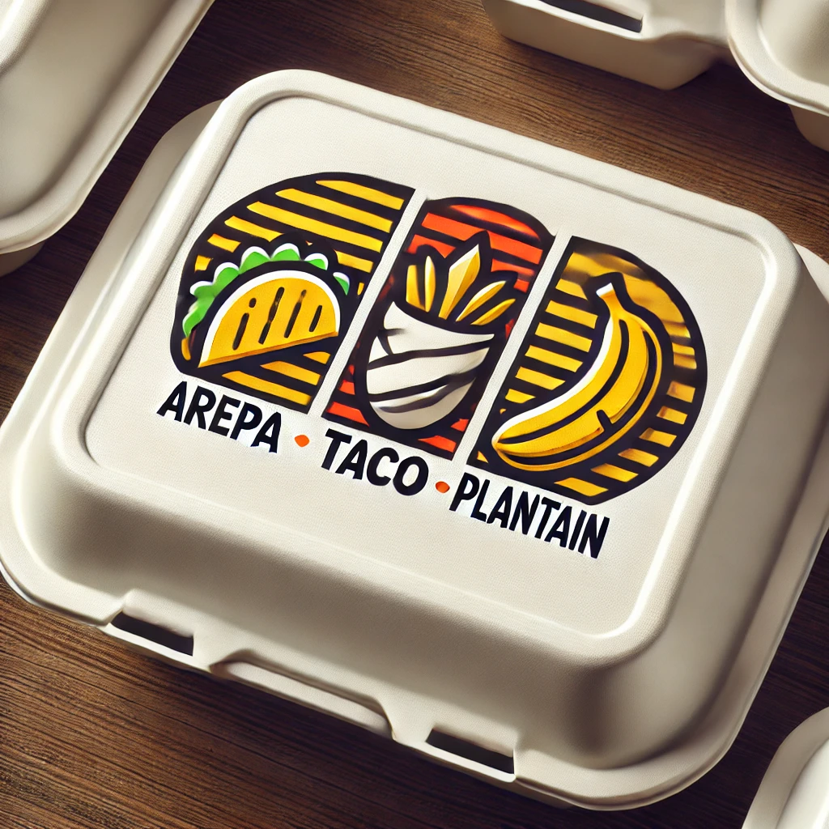
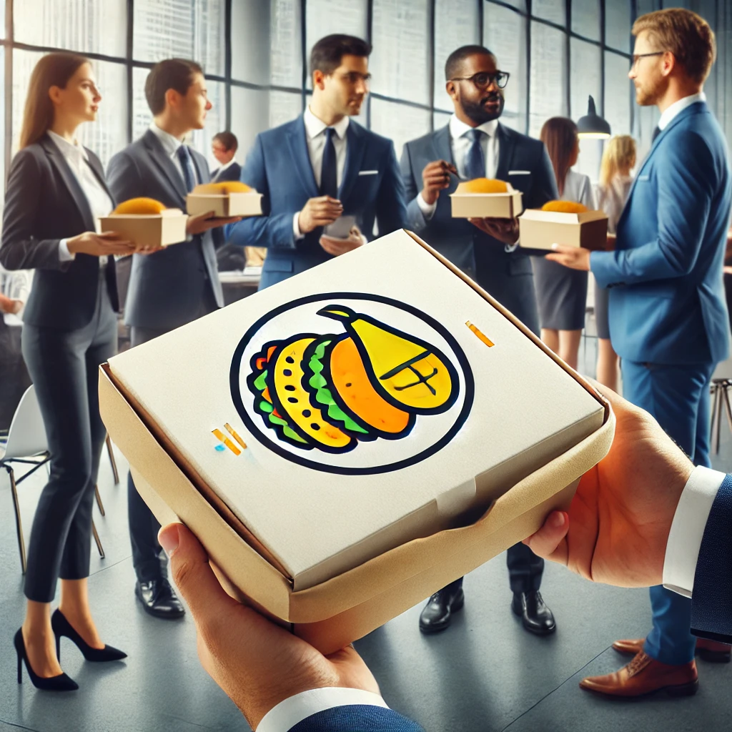
Revenue model
In-store
sales
60% gross margin
Delivery sales
50% gross margin
Corporate events
70% gross margin
Repeat customers driven by a customer loyalty program
Spoken text: Plantain and Spice will earn money from three different revenue streams, in-store purchase, delivery, and catering events. To win repeat sales, we will have a customer loyalty program and for every plate, we will allow customers to add a-la-carte options. We hope that by targeting corporations for catering events, we can charge higher prices to increase our gross profit margin from 50% for delivery and 60% in-store, to 70%.

Slide 38
REACH Hub | Business pitch
Slide 7: Market validation / traction
The market validation / traction slide presents any evidence that the entrepreneur has about whether their products and services are likely to be purchased by customers at the rate that they predict in their market potential slide (a valid market potential). This evidence comes in two forms: secondary research and traction. Usually, traction is a better indicator of market potential than just secondary research.
Traction
Traction is evidence that your business has begun to get the sincere interest (feedback) of customers. The best forms of traction involve having sold your product or service either in big or small ways with the existing customer. This form of evidence often comes from an experiment – a topic covered in the Entrepreneurial Mindset Training.
Secondary research
Secondary research (existing information) can provide some evidence that a business opportunity is valid; usually this comes from existing surveys of people about their buying habits and preferences. This can be obtained online or from market research firms.
Other forms of traction, also from experiments, comes from getting a sincere expression of interest (sign-ups to a wait list or people providing you their contact information to learn more)

Slide 39
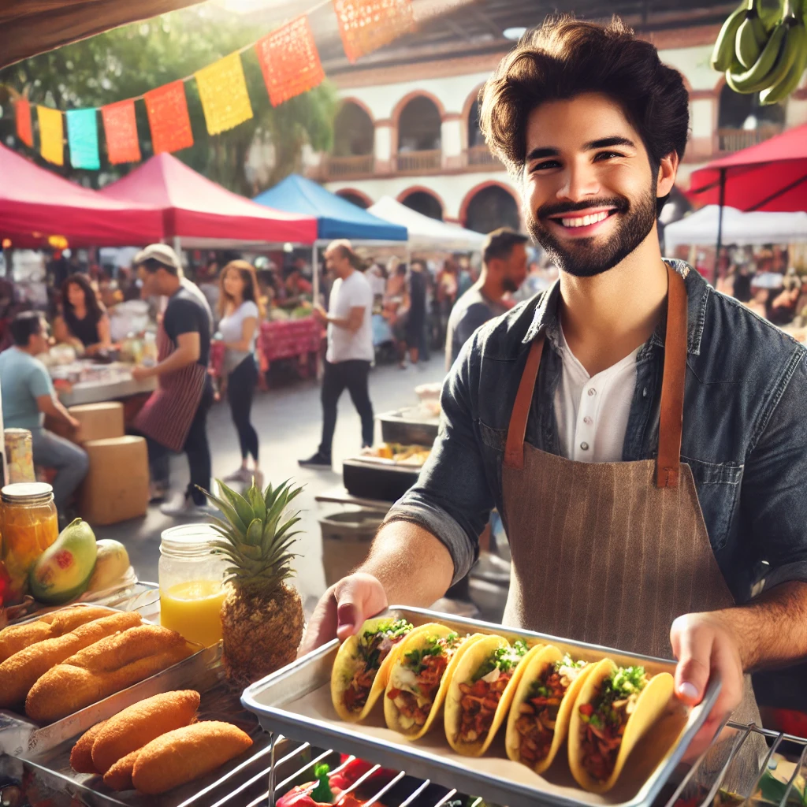
Market validation / traction
Over the last month, we have sold over $16,000 worth of the same fast-casual food we hope to sell at a once-a-week local farmer’s market.
Spoken text: Over the last month, we have sold over $16,000 worth of the same fast-casual food we hope to sell at a once-a-week local farmer’s market. This equates to $4,000 per day. This comes close to the daily revenue targets we hope that a single local of our business would bring in at $1.5 million per year per location.

Slide 40
REACH Hub | Business pitch
Slide 8: Go-to-market strategy
Go-to-market strategy
A go-to-market strategy is a plan that explains how a business will attract customers to a new business or new products/services for an existing business. Go-to-market strategies should have different approaches for different sales channels (way a product reaches a customer: like direct shipping or in-store purchase) and for different types of customers (customers with different customer profiles – see the business idea sketch module).
For each channel or type of customer, a go-to-market strategy should identify both marketing strategies (broad approaches to building a relationship with customers) and specific goals. Goals are discussed in greater depth in the entrepreneurial mindset training.
Different approaches to marketing involve a variety of media/activities,
including but not limited to the following, be sure to consider the
key advantages and limitations of each approach:
Media/ activity | Television | Social media | Web search | News & magazines | Radio | Outdoor advertising | Direct mailing | In-person selling
Advantage | Broad reach | Highly targeted, low cost | Highly targeted | Credibility and niche/local | Broad reach, time focused | Long exposure time | Highly targeted | Chance to relationship build
Limitation | Expensive | Time-intensive | Highly competitive space | Short lifespan | Limited messaging | Limited messaging | Higher cost – often discarded | Time-intensive

Slide 41
Go-to-market strategy
Target & channel | Activity | Goal
 | Fliers and social media | Increase of foot traffic by 20% after 6-month social media campaign
 | Direct mailing and web search | 10,000 deliveries per year
 | In-person visits | 10 regular corporate clients within 6 months
Spoken text: Over the next six months, we hope to engage in different types of marketing activities to drive in-person visits, deliveries, and catering events – especially for corporations. We hope to use fliers and social media to target people living within two miles of our store, direct mailing and web search for those living within three miles, and in-person visits to local corporations. We hope to increase foot traffic by 20%, get 10,000 deliveries per year, and win 10 regular corporate clients.

Slide 42
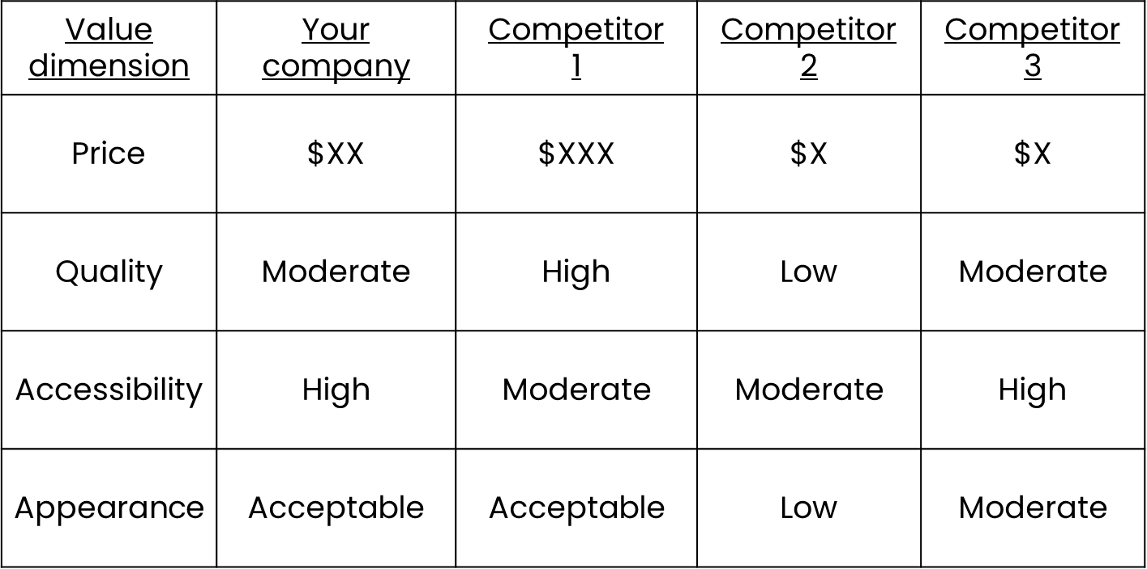
REACH Hub | Business pitch
Slide 9: Competitive landscape
If an entrepreneur has completed their business idea sketch, they will already have a competitive comparison chart that allows them to meaningfully contrast their business from their competitors. See the business idea sketch module for more information. See below for an example.
NOTE: Sometimes “your company” is presented on the right hand side of the chart.

Slide 43
Competitive landscape
Value dimension | Plantain & Spice | Fast food Mexican restaurants | Sit-down restaurants with ethnic focus | Other fast casual options with an ethnic focus
Average meal price | $20 | $12 | $25 | $15
Healthiness | High | Low | Moderate | Moderate
Speed of service | Moderate | Fast | Slow | Moderate
Variety of offerings | High | Limited | High | Limited
Spoken text: Broadly, we have three different types of competitors – we highlight ways that we are superior in dark blue or comparable in orange. We feel that we are superior to each of our competitors in different ways. While existing fast-food Mexican restaurants will be cheaper and faster, our focus on health and a variety of offerings will set us apart – especially in contrast to slower and more expensive sit-down restaurants and other fast casual options that focus on ethnic cuisine due to our variety of offerings.

Slide 44
REACH Hub | Business pitch
Slide 10: Financial projections
The financial projections slide provides insight into the business’ estimated financial future over the next 3-5 years. For a business pitch, it is traditional to present a break-even analysis. This concept was covered in the business idea sketch module.
A break-even analysis can be presented in terms of units sold and/or time depending on the nature of the business.

Slide 45
REACH Hub | Business pitch
Slide 10: Financial projections
The financial projections slide provides insight into the business’ estimated financial future over the next 3-5 years. For a business pitch, it is traditional to present a break-even analysis. This concept was covered in the business idea sketch module.
A break-even analysis can be presented in terms of units sold and/or time depending on the nature of the business.

Slide 46
REACH Hub | Business pitch
Slide 10: Financial projections
The financial projections slide provides insight into the business’ estimated financial future over the next 3-5 years. For a business pitch, it is traditional to present a break-even analysis. This concept was covered in the business idea sketch module.
A break-even analysis can be presented in terms of units sold and/or time depending on the nature of the business.
A simple-break even is an imperfect estimate of financial sustainability
We reiterate here that a break-even analysis is only an early and imperfect estimate of financial sustainability. Additional factors will need to be considered including but not limited to cash flow and carrying costs. We consider these factors in greater depth in our presentation on Financial Statements.

Slide 47
Financial projections
$1.5 million revenue by end of first year
Break-even in 12 months – assuming 5,000 meals per month
50% gross margin
$600,000 in fixed costs per year
Spoken text: As mentioned previously, by the end of the first year, we hope to earn $1.5 million annually. In addition, our fixed costs, will amount to around $600,000 per year. Our first store will break even in Quarter 4 of our first year if we sell an average of 5,000 meals per month.

Slide 48
REACH Hub | Business pitch
Slide 11: Overview of team
Investors and potential partners are often very interested in the team that is going to run a new business – or to take an existing business into the future. There are several issues that are good to highlight about the owners, managers, and other key personnel of a business.
Factor to highlight | Examples
Prior experience in a small business | Having started or worked in startups
Prior experience in the industry | Prior internship/work experience
Prior experience in key roles | Job in a large company but similar role
Knowledge of key processes or technologies | Knowledge of production/logistics
Education and certifications | Degree or digital certificate
Knowledge of customers | Being raised in the local community
Personal connection to the business topic | Passion for what the business does

Slide 49
Our team
Experience
Passion
Authenticity
Spoken text: Together, our team has: experience managing fast-casual restaurants, experience opening new restaurants, decades of experience as head chefs, and cultural backgrounds from multiple Latin American countries and a passion to share those cuisines with others.

Slide 50
REACH Hub | Business pitch
Slide 12: Investment needs & ask
The investment needs and ask slide is most relevant for potential investors because it highlights how much money is required to start a business. However, what is needed is something more than money and can include:
Key partners;
Co-founders or employees with specific skills;
Access to information.
To estimate the required amount of investment needed, a business can add up both startup costs and total costs until it breaks even. As mentioned previously, this can be calculated using the Financial Projections Template. Note – we will discuss a more exact estimate in the business plan module.
For example, based upon the break-even analysis of Plantain & Spice, the company will break even after 9 months. If their fixed costs for the entire year are $600,000, then we might estimate 3/4s of $600,000 ($450,000) as the investment needed. We might also include any startup costs. If startup costs are $50,000, then the investment need would be $500,000.

Slide 51
What we need
Contact with a marketing agency specializing in helping fast-casual restaurants
$500,000 for startup and operating expenses
Spoken text: To get started, we need $500,000 in investment – predominately for kitchen equipment, rent, and labor costs. We also could use contact with a marketing agency that specializes in helping fast-casual restaurants to reach new local markets.

Slide 52
REACH Hub | Business pitch
Slide 13: Summary & vision
The summary and vision slide should return to the “big picture” – including the basics of the business idea sketch: how the idea is a solution to a problem, superior to competitors, sensible to undertake, financially sustainable, and sweet to investors. See the business idea sketch module for a review.
This can be accomplished by re: highlighting the value proposition statement and briefly mentioning key points from throughout the presentation.
Summary and vision slides often end by reinforcing the future earnings potential of the idea to help convince those listening to the presentation to get involved and/or support.

Slide 53
Summary & vision
From a local farmer’s market
To locations across the country
Spoken text: In short, we are Plantain & Spice – we help those looking for a healthy fast-casual option to discover new cuisines while saving money. We can break even within a year by upselling our plates, leveraging delivery, and catering to corporations. With our experienced team, we understand how to open not just one, but dozens of stores over the next several years – generating a huge opportunity for our investors and partners.

Slide 54
REACH Hub | Business pitch
Overview
What is a business pitch and what is it used for?
What is in a pitch deck?
How should entrepreneurs make presentations?
Summary
What’s next

Slide 55
REACH Hub | Business pitch
Presentation skills
Presentation skills are very important for business pitches, but many entrepreneurs do not follow key best practices that lead to success:
Do NOT include more than 30 words per slide (unless you are emailing a slide deck to someone who will not have you explaining it); this rule is important because if you have too much text, listeners will not listen to you and will instead read your slides. Ideally you should use 20 or fewer words.
Instead of text, emphasize images (which should reinforce and remind the entrepreneur of key messages to be made);
Do NOT memorize what you are going to say for every slide, instead, allow the images on the slides and speaker’s notes to remind you of key points to be made; while it is tempting to memorize a script, a nervous presenter will likely make a mistake leading to anxiety and further mistakes;
In contrast to memorization, a more natural conversational style where an entrepreneur speaks to their audience explaining what is on a slide is usually more engaging and less prone to problems;
To feel comfortable presenting, be sure to practice – when you practice, remember that it is okay (better) to make a presentation using slightly different phrasing each time.

Slide 56
REACH Hub | Business pitch
Overview
What is a business pitch and what is it used for?
What is in a pitch deck?
How should entrepreneurs make presentations?
Summary
What’s next

Slide 57
REACH Hub | Business pitch
Summary
Business pitches are the presentation of a new idea for a business, the future potential for an existing business, or the future potential of an addition/change to an existing business;
Business pitches can be used to develop an idea, communicate to others, or seek funding/investment from others;
Pitch decks build upon a business idea sketch and are made up of 10-20 slides on key topics that help to communicate how a business idea is a solution to a problem, superior to competitors, sensible to undertake, sustainable financially, and sweet (attractive to investors);
When presenting business pitches, entrepreneurs should use minimal wording and emphasize a natural conversational style and use supporting imagery.

Slide 58
REACH Hub | Business pitch
Overview
What is a business pitch and what is it used for?
What is in a pitch deck?
How should entrepreneurs make presentations?
Summary
What’s next

Slide 59
REACH Hub | Business pitch
Equity-based
investment
Debt- and other financing
Introduction to financing
ESOPs
Contracts
Financial management
Accounting basics: tax & audits
Making it official & attorneys
Business plan
Basics of bookkeeping
Business pitch
Business idea sketch

Slide 60
REACH Hub | Business pitch
Equity-based
investment
Debt- and other financing
Introduction to financing
ESOPs
Next steps
After engaging with this presentation on business pitches, a good next step is reviewing material on putting together Business Plans.
Contracts
Financial management
Accounting basics: tax & audits
Making it official & attorneys
Business plan
Basics of bookkeeping
Business pitch
Business idea sketch

