Slide 1





Business idea sketch
REACH Hub
Resources for Entrepreneurship Advising & Coaching

Slide 2
REACH Hub | Financial statements
Our approach
Throughout the REACH Hub, we aim to ensure that resources SPEAK, that is, that they are:
  Simple – clear and without unnecessarily complication
  Psychological – focused on helping entrepreneurs think effectively
  Empowering – centered on SEDI populations
  Aligned – relevant to and linked with other approaches
  Knowledge-based – built on research-based insights

Slide 3


REACH Hub | Financial statements
Our approach
Throughout the REACH Hub, we aim to ensure that resources SPEAK, that is, that they are:
  Simple – clear and without unnecessarily complication
  Psychological – focused on helping entrepreneurs think effectively
  Empowering – centered on SEDI populations
  Aligned – relevant to and linked with other approaches
  Knowledge-based – built on research-based insights
Helpful call-outs
Throughout this presentation, there are special slides that provide additional information. They are indicated by transparent grey backgrounds like this one.
Mindset: this logo indicates that the call-out is related to an entrepreneurial mindset – a topic covered in the Reach Hub’s Entrepreneurial Mindset Training
Coach/advisor tip: this logo indicates that the call-out is related to advice designed for a coach or advisor who is working with a small business or entrepreneur
Links are underlined
This presentation includes links to other resources in the REACH Hub indicated by underlined text

Slide 4
REACH Hub | Business idea sketch
Purpose
The purpose of this presentation is to provide you an introduction to business models and how to create them in a simple yet effective and unified way. As seen on the next slide, this is an excellent starting point both for new businesses but also for businesses that are re-thinking their future directions or planning for significant growth/change.
Disclaimer:
The information provided in this content does not, and is not intended to, constitute: legal advice, accounting, tax, financial advice, an offer to buy or sell securities, nor is it intended as financial or investment advice; instead, all information, content, and materials available in this content are for general educational purposes only. Information in this content may not constitute the most up-to-date legal, financial, accounting, financial, or investment information. The content may contain links to other third-party websites and to content generated by third parties. Such links and content are only for the convenience of the user; the authors of this content do not recommend or endorse the content of any third-party sites or content.

Slide 5
REACH Hub | Business idea sketch
Equity-based
investment
Debt-based and other financing
Introduction to financing
ESOPs
Contracts
Financial management
Accounting basics: tax & audits
Making it official & attorneys
Business plan
Basics of bookkeeping
Business pitch
Business idea sketch

Slide 6
REACH Hub | Business idea sketch
Overview
What is a business model?
The "5S" framework
Solution to a problem
Superior to competitors
Sensible to undertake given resources & partners
Sustainable financially
Sweet to investors
Summary
What’s next

Slide 7
REACH Hub | Business idea sketch
Overview
What is a business model?
The "5S" framework
Solution to a problem
Superior to competitors
Sensible to undertake given resources & partners
Sustainable financially
Sweet to investors
Summary
What’s next

Slide 8
REACH Hub | Business idea sketch
Business model
A business model is a company’s plan to make money by delivering value to their customers.
Business models are important for both new and existing businesses;
Business models can be reflected simply, like on a single piece of paper, reflected in moderate detail via a slide deck, or can be written out in great detail via a business plan;
When developing or changing your business model, it is useful to first use a simple one-page “sketch” to ensure that you have touched upon all aspects of your business model.

Slide 9
REACH Hub | Business idea sketch
Overview
What is a business model?
The "5S" framework
Solution to a problem
Superior to competitors
Sensible to undertake given resources & partners
Sustainable financially
Sweet to investors
Summary
What’s next

Slide 10
REACH Hub | Business idea sketch
The “5S” framework
The “5S” framework is a set of considerations, arranged visually like a canvas, that helps entrepreneurs to think about all major aspects of their business model in a simple and unified way – we call this a Business idea sketch

Slide 11
REACH Hub | Business idea sketch
Business idea sketch
Each area in the canvas represents a different aspect of a business model and starts with the letter “S” to help entrepreneurs easily remember what goes in each area
Sweet to investors
Sensible to do with resources available
Solution to a problem
Superior to competitors
Sustainable financially

Slide 12
REACH Hub | Business idea sketch
Overview
What is a business model?
The "5S" framework
Solution to a problem
Superior to competitors
Sensible to undertake given resources & partners
Sustainable financially
Sweet to investors
Summary
What’s next

Slide 13
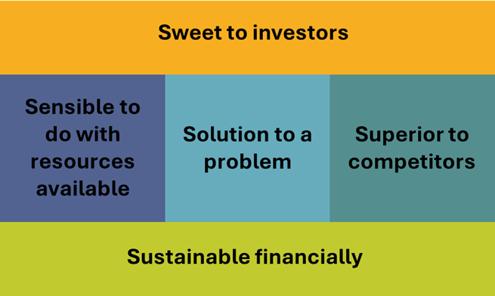
REACH Hub | Business idea sketch
Solution to a problem
Good business ideas are first and foremost a solution to a problem that customers actually have
How does an entrepreneur make sure their business idea is a solution to a problem?
Step 1: Build a customer profile
Step 2: Create a value proposition statement Step 3: Make sure your value speaks to your customer

Slide 14

REACH Hub | Business idea sketch
Step 1: Create a customer profile
A customer profile is a way to “get inside customers heads” to understand them from a psychological perspective; it helps an entrepreneur honestly evaluate whether their customers will want certain products/services
At first, an entrepreneur will need to use their best judgement as to what the profile of their likely customers is; later, they will go out to confirm their assumptions

Slide 15
REACH Hub | Business idea sketch
Customer profiles are made up understanding customers’ goals and problems
Component | Examples
List of customer goals – things your customers want to do and ways they want to feel | I want to be able to build X in just three hours I want to feel better about myself when doing Y I want to feel like Z
List of customer problems – things that stand in the way of your customers’ goals | I am spending too much money buying X I have difficulty finding Y I am not able to Z when I am at home

Slide 16
REACH Hub | Business idea sketch
Demographics might not matter!
A customer profile is NOT just a list of demographics (age, sex, income, etc.) – these factors might or might not be relevant and sometimes entrepreneurs waste a lot of time thinking about such factors when they don’t matter
There might be more than one customer profile…
If different groups of people have meaningfully different goals and problems, there might be more than one customer profile; if so, you will need to develop unique value for each profile

Slide 17


REACH Hub | Business idea sketch
Customer profile examples
Company type:
Marketing firm for small businesses
Company type:
Restaurant
Customer profile
Customer profile
Customer goals
- Get a quick meal during lunchtime - Eat healthy - Explore new and different types of cuisine
Customer problems
- Fast food is quick but not healthy - Sit-down restaurants in the area are slow - Getting food delivered is expensive
Customer goals
Connect with Gen Z Build a presence on social media Reduce ad spending by 20%
Customer problems
Lack of familiarity with what Gen Z wants No social media skills Little to no time to learn new skills or monitor social media accounts

Slide 18
REACH Hub | Business idea sketch
Step 1: Create a customer profile
Don’t assume they want it
Entrepreneurs often assume that customers want their products/services, when in reality, they don’t like them enough to buy them; encourage the entrepreneur to be honest in their profile and if they don’t know their customers well, then have them go out and spend time learning more about them
Customer profiles have three components/parts:
Customer profile component | Examples
List of customer goals – things your customers want (both what they want to do and how they want to feel) | I want to be able to build X in just three hours I want to feel better about myself when doing X
List of customer problems – things that stand in the way of your customers’ goals | I am spending too much money buying X I have difficulty finding X
List of customer solutions – the things a customer has, and ways that a customer already is, solving their problems (these are likely not perfect) | I combine, X, Y, and Z – even though they are not meant to go together I go without doing X from time to time
Improve your profile!
It will likely be easy for entrepreneurs to come up with just a few basic goals and problems– challenge them to come up with several more with greater detail for a deeper understanding of their customers

Slide 19

REACH Hub | Business idea sketch
Step 2: Create a value proposition statement
Value proposition statements are one-sentence descriptions of who a business is helping, how they are helping, and why this help is better than others
Value
proposition
statement
Value proposition statements allow an entrepreneur to quickly and clearly tell others what their business idea is – if this process is difficult for the entrepreneur, it often means they are themselves not certain about what their business does or will do

Slide 20
REACH Hub | Business idea sketch
Follow the following format for a value proposition statement
Key questions | Value proposition statement format | Example of a new type of Mexican restaurant | Example of a new type of business software
Who you are helping | We help…
 | Brief description of customer and their goals | Those that love Mexican cuisine | Small businesses owned by the Baby Boomer generation
 | To…
 | Mention of customer goals and problems | save money and eat healthy in an environment that makes them feel at home | more effectively reach out to Gen Z customers
How you are helping | By…
 | Way problem is solved | creating a comfortable quick dining experience | providing user-friendly online software that develops marketing ideas
Why you are better than others | Better than…
 | Key types of competitors | fast food and more expensive sit-down restaurants in the area | expensive marketing agencies and online tutorials

Slide 21
REACH Hub | Business idea sketch
Customer profile examples
Company type:
Marketing firm for small businesses
Company type:
Restaurant
Value proposition statement
Value proposition statement
We help those that love Mexican cuisine to save money and eat healthy in an environment that makes them feel at home, by creating a comfortable dining experience better than fast food and more expensive sit-down restaurants in the area
We help small businesses owned by the Baby Boomer generation to more effectively reach out to Gen Z customers, by delivering online software that develops marketing ideas better than expensive marketing agencies and online tutorials

Slide 22
REACH Hub | Business idea sketch
Customer profile examples
Company type:
Marketing firm for small businesses
Company type:
Restaurant
Developing and improving value propositions matter for existing businesses as much as for new ones
Even after years of operating, entrepreneurs can benefit from creating value proposition statements – and ensuring that these statements really reflect what is needed by the profiles of their existing customers. Both the goals and problems of customers can change across time – as well as the appeal for certain types of solutions. During times of change or crisis, it is often a good idea to have a business return to these basics.
Value proposition statement
Value proposition statement
We help those that love Mexican cuisine to save money and eat healthy in an environment that makes them feel at home, by creating a comfortable quick dining experience better than fast food and more expensive sit-down restaurants in the area.
We help small businesses owned by the Baby Boomer generation to more effectively reach out to Gen Z customers, by delivering online software that develops marketing ideas better than expensive marketing agencies and online tutorials.

Slide 23
REACH Hub | Business idea sketch
Step 3: Test whether your value proposition solves your customers’ problems
There are at least three ways to test whether your value proposition will solve your customers’ problems, they all have different advantages and disadvantages
Method | Brief description | Advantage | Disadvantage
Compare them yourself | Line up your value proposition statement and customer profile to spot any gaps | Fast and easy | High possibility of misunderstanding your customers
Talk with your customers | Go out and have open-ended conversations with your customers | Generates lots of useful insights | Customers might not know what they want or might not tell you
Conduct a mini experiment | Using a very early version of your products/services, test whether customers like it enough to buy it | Very good evidence that customers want what you will sell | Relatively time consuming

Slide 24
REACH Hub | Business idea sketch
Step 3: Test whether your value proposition solves your customers’ problems
There are at least three ways to test whether your value proposition will solve your customers’ problems, they all have different advantages and disadvantages
Getting high-quality feedback on your ideas as an entrepreneur is important both as an existing and new business, we cover this topic in depth in the SCALE-network entrepreneurial mindset training
Method | Brief description | Advantage | Disadvantage
Compare them yourself | Line up your value proposition statement and customer profile to spot any gaps | Fast and easy | High possibility of misunderstanding your customers
Talk with your customers | Go out and have open-ended conversations with your customers | Generates lots of useful insights | Customers might not know what they want or might not tell you
Conduct a mini experiment | Using a very early version of your products/services, test whether customers like it enough to buy it | Very good evidence that customers want what you will sell | Relatively time consuming

Slide 25
REACH Hub | Business idea sketch
Step 3: Test whether your value proposition solves your customers’ problems
There are at least three ways to test whether your value proposition will solve your customers’ problems, they all have different advantages and disadvantages
Experimentation is an effective way for entrepreneurs to explore new business ideas and to improve their existing businesses, we cover this topic in depth in the SCALE-network entrepreneurial mindset training
Method | Brief description | Advantage | Disadvantage
Compare them yourself | Line up your value proposition statement and customer profile to spot any gaps | Fast and easy | High possibility of misunderstanding your customers
Talk with your customers | Go out and have open-ended conversations with your customers | Generates lots of useful insights | Customers might not know what they want or might not tell you
Conduct a mini experiment | Using a very early version of your products/services, test whether customers like it enough to buy it | Very good evidence that customers want what you will sell | Relatively time consuming

Slide 26
REACH Hub | Business idea sketch
Step 3: Test whether your value proposition solves your customers’ problems
We focus here in this presentation on an entrepreneur’s own comparison between their customer profiles and value proposition statements; however, while fast and easy, this should not substitute for more robust engagement with customers – and a small experiment is often the only way to know for sure whether customers will like your product/service enough to buy it
There are at least three ways to test whether your value proposition will solve your customers’ problems, they all have different advantages and disadvantages
Method | Brief description | Advantage | Disadvantage
Compare them yourself | Line up your value proposition statement and customer profile to spot any gaps | Fast and easy | High possibility of misunderstanding your customers
Talk with your customers | Go out and have open-ended conversations with your customers | Generates lots of useful insights | Customers might not know what they want or might not tell you
Conduct a mini experiment | Using a very early version of your products/services, test whether customers like it enough to buy it | Very good evidence that customers want what you will sell | Relatively time consuming

Slide 27
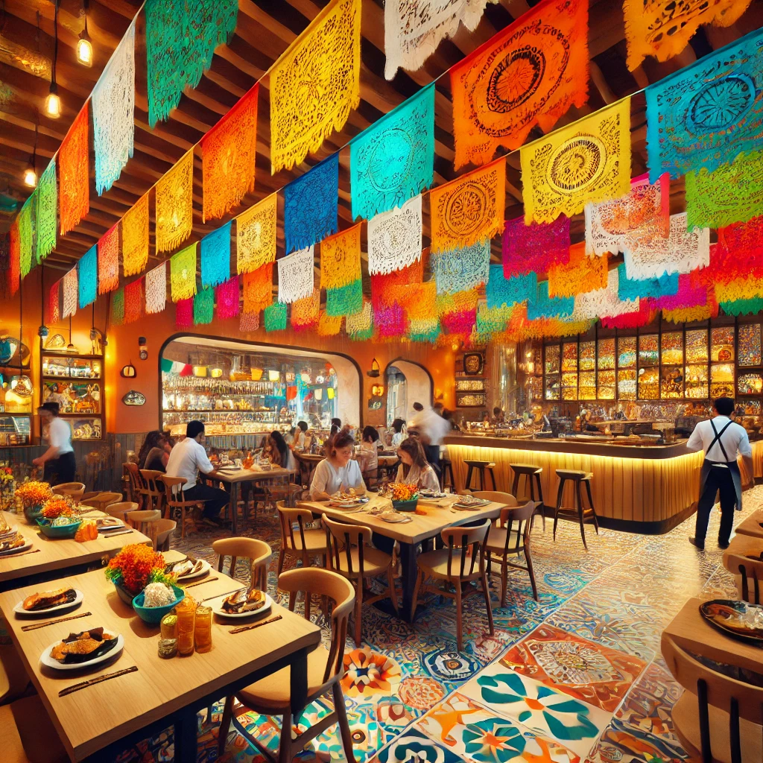

REACH Hub | Business idea sketch
Does your value proposition support customer goals and solve their problems?
Customer profile
Example comparison
Unclear how fast the service will be – current emphasis is on comfort and feeling at home
Value proposition statement
Customer goals
- Get a quick meal during lunchtime - Eat healthy - Explore new and different types of cuisine
Customer problems
- Fast food is quick but not healthy - Sit-down restaurants in the area are slow - Getting food delivered is expensive
We help those that love Mexican cuisine to save money and eat healthy in an environment that makes them feel at home, by creating a comfortable dining experience better than fast food and more expensive sit-down restaurants in the area
Business will offer healthy food
Unclear whether just a focus on Mexican food is new and different
?
Does not appear to solve all problems – besides being healthy and cheaper than delivery

Slide 28
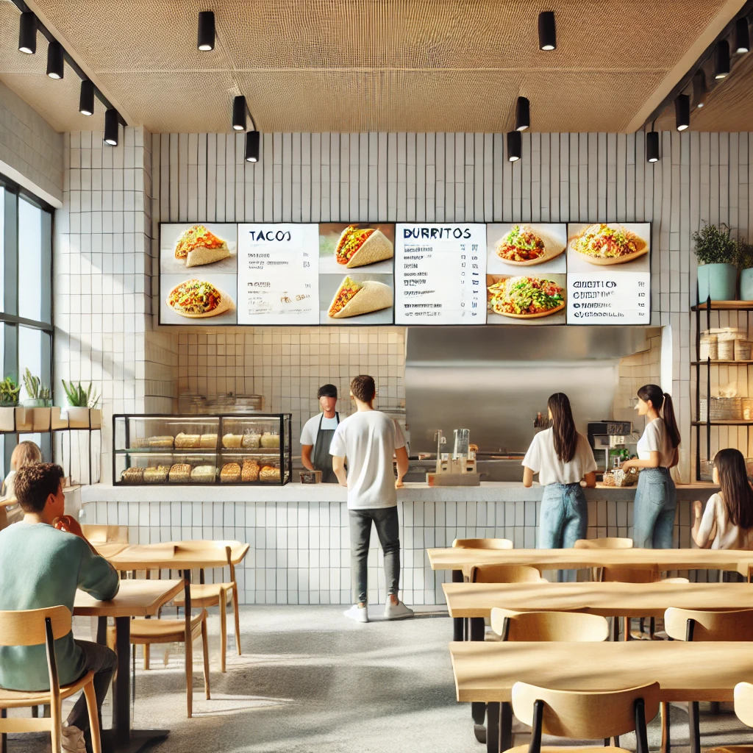
REACH Hub | Business idea sketch
If there was not a good fit between your value proposition and your customer’s goals and problems – change your value proposition
Customer profile
New value proposition statement
Fast-casual will support a quick lunch
Customer goals
- Get a quick meal during lunchtime - Eat healthy - Explore new and different types of cuisine
Customer problems
- Fast food is quick but not healthy - Sit-down restaurants in the area are slow - Getting food delivered is expensive
We help those that love exploring new cuisines to save money and eat healthy, by creating a fast-casual dining experience with a variety of Latin American cuisines – healthier than fast food and quicker than more expensive sit-down restaurants
Business will offer healthy food
Variety of cuisines will allow for trying new and different foods
Does not appear to solve most problems – besides being cheaper than delivery

Slide 29

REACH Hub | Business idea sketch
If there was not a good fit between your value proposition and your customer’s goals and problems – change your value proposition
Customer profile
Change your idea or change your customers
(as long as they actually exist)
If the match between a value proposition statement and a customer profile is not great, it will require you to change up the business idea; however, it is also possible you could stay with the same idea and just target a different customer profile. However, many entrepreneurs often are so in love with their ideas that they convince themselves that a certain type of customer will like their business – even if those customers do not exist or exist only in small numbers.
New value proposition statement
Fast-casual will support a quick lunch
Customer goals
- Get a quick meal during lunchtime - Eat healthy - Explore new and different types of cuisine
Customer problems
- Fast food is quick but not healthy - Sit-down restaurants in the area are slow - Getting food delivered is expensive
We help those that love exploring new cuisines to save money and eat healthy, by creating a fast-casual dining experience with a variety of Latin American cuisines – healthier than fast food and quicker than more expensive sit-down restaurants
Business will offer healthy food
Variety of cuisines will allow for trying new and different foods
Does not appear to solve most problems – besides being cheaper than delivery

Slide 30
REACH Hub | Business idea sketch
Overview
What is a business model?
The "5S" framework
Solution to a problem
Superior to competitors
Sensible to undertake given resources & partners
Sustainable financially
Sweet to investors
Summary
What’s next

Slide 31
REACH Hub | Business idea sketch
Superior to competitors
Good business ideas are not just different, but better than, those of competitors according to factors that customers care about.
How does an entrepreneur make sure their business idea is superior to competitors?
Create a competitive- superiority chart

Slide 32
REACH Hub | Business idea sketch
General example of value- dimensions and competitor comparison
Structure of chart
A competitive superiority chart takes the things that are most important about your products/services from your customer profile and value proposition statement, and then compares them against your top competitors (ideally 3-5 competitors); each row should be along a simple type of rating (for example high/medium/low or the $ value of product/service).
Value dimension | Your company | Competitor 1 | Competitor 2 | Competitor 3
Price | $XX | $XXX | $X | $X
Quality | Moderate | High | Low | Moderate
Accessibility | High | Moderate | Moderate | High
Appearance | Acceptable | Acceptable | Low | Moderate

Slide 33
REACH Hub | Business idea sketch
General example of value- dimensions and competitor comparison
Value dimension | Your company | Competitor 1 | Competitor 2 | Competitor 3
Price | $XX | $XXX | $X | $X
Quality | Moderate | High | Low | Moderate
Accessibility | High | Moderate | Moderate | High
Appearance | Acceptable | Acceptable | Low | Moderate

Slide 34
REACH Hub | Business idea sketch
Specific example of a competitive comparison for a restaurant (see prior example)
Value dimension | Latin American fast casual (your business) | Competitor 1: Fast food Mexican restaurant | Competitor 2: Sit-down African restaurant | Competitor 3: Cuban fast casual
Average meal price | $20 | $12 | $20 | $15
Healthiness | High | Low | Moderate | Moderate
Speed of service | Moderate | Fast | Slow | Moderate
Variety of offerings | High | Limited | High | Limited

Slide 35
REACH Hub | Business idea sketch
Specific example of a competitive comparison for a restaurant (see prior example)
Value dimension | Latin American fast casual (your business) | Competitor 1: Fast food Mexican restaurant | Competitor 2: Sit-down African restaurant | Competitor 3: Cuban fast casual
Average meal price | $20 | $12 | $20 | $15
Healthiness | High | Low | Moderate | Moderate
Speed of service | Moderate | Fast | Slow | Moderate
Variety of offerings | High | Limited | Moderate | Limited
The value dimensions you use to describe and compare your value proposition with should come from your value proposition statement and your customer profile – what are the most important parts of the value you hope to provide?

Slide 36
REACH Hub | Business idea sketch
Specific example of a competitive comparison for a restaurant (see prior example)
Value dimension | Latin American fast casual (your business) | Competitor 1: Fast food Mexican restaurant | Competitor 2: Sit-down African restaurant | Competitor 3: Cuban fast casual
Average meal price | $15 | $12 | $20 | $15
Healthiness | High | Low | Moderate | Moderate
Speed of service | Moderate | Fast | Slow | Moderate
Variety of offerings | High | Limited | Moderate | Limited
The list of your competitors should come from your value proposition statement: what other competitors provide similar value to you?
Many entrepreneurs will falsely believe they have no competitors – encourage them to look for indirect competitors that provide similar forms of value – even if the competitor seems quite different. For example, Competitor 2 is an African restaurant, in one sense very different from a Latin American restaurant, but they provide a variety of cuisines that allow their customers the ability to explore new cuisines – similar to the restaurant being proposed.

Slide 37
REACH Hub | Business idea sketch
Specific example of a competitive comparison for a restaurant (see prior example)
Value dimension | Latin American fast casual | Competitor 1: Fast food Mexican restaurant | Competitor 2: Sit-down African restaurant | Competitor 3: Cuban fast casual
Average meal price | $15 | $12 | $20 | $15
Healthiness | High | Low | Moderate | Moderate
Speed of service | Moderate | Fast | Slow | Moderate
Variety of offerings | High | Limited | High | Limited
Make the comparison easy to make
To help make the superiority chart more meaningful, code each of the dimensions in the same way; for example, color better ratings blue, okay ratings orange, and bad ratings grey. Or turn everything into check marks with better evaluations leading to more check marks.

Slide 38
REACH Hub | Business idea sketch
Example of color coding
Value dimension | Latin American fast casual (your business) | Competitor 1: Fast food Mexican restaurant | Competitor 2: Sit-down African restaurant | Competitor 3: Cuban fast casual
Average meal price | $20 | $12 | $25 | $15
Healthiness | High | Low | Moderate | Moderate
Speed of service | Moderate | Fast | Slow | Moderate
Variety of offerings | High | Limited | High | Limited

Slide 39
REACH Hub | Business idea sketch
Are you clearly better?
Your proposed business idea should be clearly better than your closest competitors, if not, then you will need to go back and revise your idea and value proposition statement.
Example of color coding
Value dimension | Latin American fast casual | Competitor 1: Fast food Mexican restaurant | Competitor 2: Sit-down African restaurant | Competitor 3: Cuban fast casual
Average meal price | $20 | $12 | $20 | $15
Healthiness | High | Low | Moderate | Moderate
Speed of service | Moderate | Fast | Slow | Moderate
Variety of offerings | High | Limited | High | Limited
Don’t be overconfident!
A lot of entrepreneurs make the mistake of having an entirely positive comparison of them to their competitors. This is usually a sign that the entrepreneur does not yet understand how difficult it will be do accomplish certain things (for example, offering high quality at a low price).

Slide 40
REACH Hub | Business idea sketch
Overview
What is a business model?
The "5S" framework
Solution to a problem
Superior to competitors
Sensible to undertake given resources & partners
Sustainable financially
Sweet to investors
Summary
What’s next

Slide 41
REACH Hub | Business idea sketch
Sensible to do with available resources
Good business ideas are those that the entrepreneur can do with resources that they have – or a workable plan to find and get
How does an entrepreneur make sure their business idea is sensible?
List the required activities, resources, and partners
for a business idea

Slide 42

REACH Hub | Business idea sketch
A business can be thought of a combination of different activities, resources, and partners
Component | Description
Activities | Processes or tasks that are important to the business
Resources | Things, information, and people that your business has
Partners | Things, information, people, and organizations that your business works with (external to your business)

Slide 43
REACH Hub | Business idea sketch
Business areas | Description | Example activities | Example resources | Example partners
Sales and support | Selling to customers and making sure they are happy | Answering customer calls | Receptionist | Call center
Attracting customers | Getting and maintaining the attention of customers | Posting on social media | Social media accounts | Marketing firm
Outbound logistics | Getting products/services to customers | Shipping | Truck | Logistics firm
Production/ processing | Making products/services | Assembly or data analysis | Materials or information | Overseas manufacturer
Logistics and procurement | Finding and acquiring the elements of your product/ service | Inventory management | List of good suppliers | Suppliers
Research and development | Creating ideas and resources for new products/ services | Design and customer research | Market research data | Market research firm
Management and leading | Ensuring the other activities run smoothly and directing the company in new directions | Accounting, finance, human resources | Managers | Legal or accounting firm
A business is made up of seven different “areas” – with the activities closest to customers at the top

Slide 44
REACH Hub | Business idea sketch
For each area, a business has different activities, resources, and partners
Business areas | Example activities | Example resources | Example partners
Sales and support | Answering customer calls | Receptionist | Call center
Attracting customers | Posting on social media | Social media accounts | Marketing firm
Outbound logistics | Shipping | Truck | Logistics firm
Production/ processing | Assembly or data analysis | Materials or information | Overseas manufacturer
Logistics and procurement | Inventory management | List of good suppliers | Suppliers
Research and development | Design and customer research | Market research data | Market research firm
Management and leading | Accounting, finance, human resources | Managers | Legal or accounting firm

Slide 45
REACH Hub | Business idea sketch
To evaluate how sensible a business is, identify the activities, resources, and partners required for each area
Business areas | Important activities | Important resources | Important partners | Plan to find/get
Sales and support | Speedy taking of orders | POS hardware | POS software company
Attracting customers | Online advertising | Good location & welcoming interior | Real estate agent, interior designer
Outbound logistics | Making deliveries | Trained cashier | Delivery apps
Production/ processing | Food preparation | Experienced chef | N/A
Logistics and procurement | On-time ordering | Restaurant owner | Food supply companies
Research and development | Surveying customers | Database of customer info | N/A
Management and leading | Hiring and chef training | Better knowledge of chef training | N/A
This example is of the Latin American fast casual restaurant
(see above), we are assuming it has a physical location and also a delivery service

Slide 46
REACH Hub | Business idea sketch
To evaluate how sensible a business is, identify the activities, resources, and partners required for each area
Business areas | Important activities | Important resources | Important partners | Plan to find/get
Sales and support | Speedy taking of orders | N/A | POS software company
Attracting customers | Online advertising | Good location & welcoming interior | Real estate agent, interior designer
Outbound logistics | Making deliveries | Trained cashier | Delivery apps
Production/ processing | Food preparation | Experienced chef | N/A
Logistics and procurement | On-time ordering | Restaurant owner | Food supply companies
Research and development | Surveying customers | Database of customer info | N/A
Management and leading | Hiring and chef training | Better knowledge of chef training | N/A
Focus on important and difficult activities, resources, and partners
It is not helpful or necessary to identify all activities, resources, and partner involved in a business idea; instead, it is good to focus on those that are both important and difficult to do relatively well. For example, while hiring employees for certain positions is often very important, if those positions do not require unusual skills, hiring people for those positions might not be difficult.
Developing a plan to find/get resources and partners highlights gaps in entrepreneurial knowledge
If entrepreneurs’ plans to find/get key resources and partners (and if it remains unclear what activities, resources, and partner are required), then the entrepreneur likely needs to know more about the business before they can evaluate the sensibleness of the idea. Having the entrepreneur contact others in the industry to learn more might be critical.
This example is of the Latin American fast casual restaurant
(see above), we are assuming it has a physical location and also a delivery service

Slide 47
REACH Hub | Business idea sketch
Overview
What is a business model?
The "5S" framework
Solution to a problem
Superior to competitors
Sensible to undertake given resources & partners
Sustainable financially
Sweet to investors
Summary
What’s next

Slide 48
REACH Hub | Business idea sketch
Sustainable financially
Good business ideas are those that will make money, if not right away, then in the foreseeable future
How does an entrepreneur make sure their business idea is financially sustainable?
Entrepreneurs needs to determine when they can generate enough money through sales to begin paying off their expenses, this is a multi-step process:
Step 1: Estimate your expenses;
Step 2: Estimate the money you will earn;
Step 3: Calculate how long it will take to pay off your expenses

Slide 49
REACH Hub | Business idea sketch
Step 1: Estimate your expenses
To determine how long it will take to pay off expenses, you will first need to estimate your cost of goods sold (COGS) and other fixed costs to get your business started
As also explained in the income statement module, COGS are those expenses that are directly related to you producing a single unit of your product/services.
Other expenses to consider at this stage besides COGS are fixed costs (costs that do not change in connection with how much you produce).
Examples of COGS:
Supplies to make or prepare a single unit of product/service;
Shipping or packaging materials for a single unit;
Labor to build, cook, or create a specific product/service.
Examples of fixed costs:
Rent;
Machinery or tools that can be used again and again;
Salaries of employees who you hire long-term;
Administrative expenses.

Slide 50
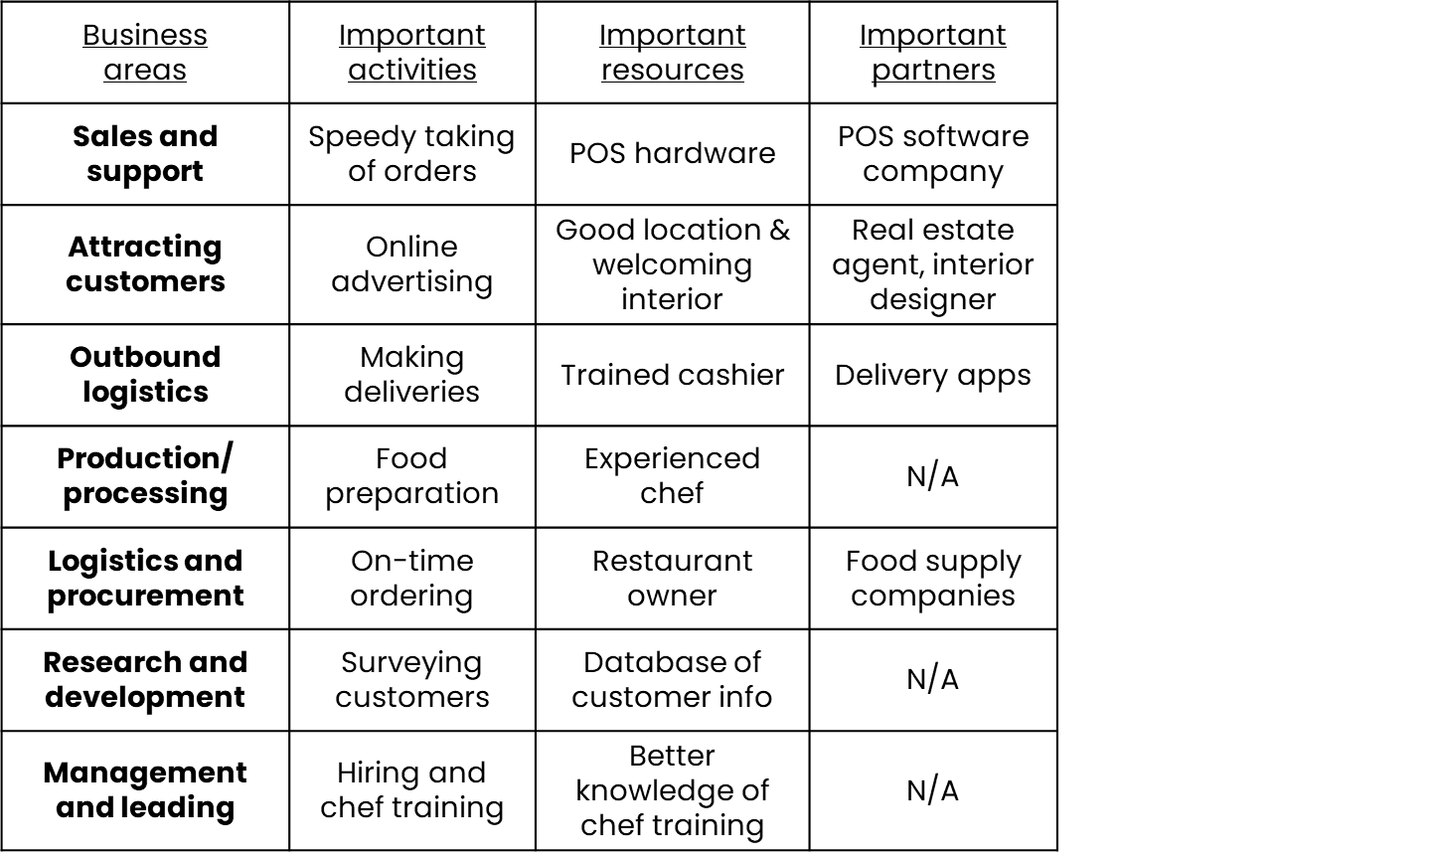
REACH Hub | Business idea sketch
Step 1: Estimate your expenses
From the list of activities, resources, and partners (from the sensibility section), begin to estimate major costs involved in starting your business and operating; we use the example of the Latin American restaurant from before
Major costs:
Food, beverages, and dining supplies
Cooks and servers
Kitchen equipment
Commercial lease
Administrative staff
Contracts with POS-system company, real estate agent, marketing firm, and interior designer

Slide 51
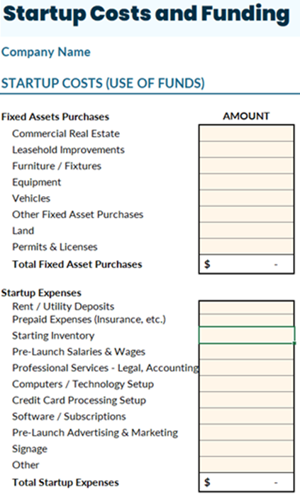
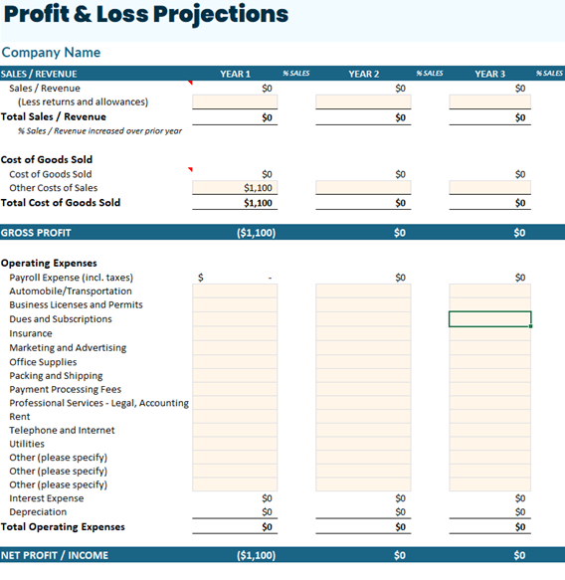
REACH Hub | Business idea sketch
Step 1: Estimate your expenses
Estimating your expenses can be done via the Financial Projections Template. This template breaks expenses into three categories: COGS, operating expenses (fixed costs), and startup expenses. When calculating your major costs within the business idea sketch, you can either include or exclude startup costs depending on your preference.

Slide 52
REACH Hub | Business idea sketch
Step 1: Estimate your expenses
Here is an example of classifying major costs into COGS and fixed costs
Major costs:
Food, beverages, and dining supplies
Cooks and servers
Kitchen equipment
Commercial lease
Administrative staff
Contracts with POS-system company, real estate agent, marketing firm, and interior designer
$10 COGS per meal
COGS
$600,000 for one year
Fixed costs

Slide 53
REACH Hub | Business idea sketch
Step 2: Estimate the money you will earn
At its most basic level, the money you will earn as a business is related to the price an entrepreneur will charge for your products or services. What your price should be is a decision that has multiple considerations. In particular, there are three approaches; the entrepreneur should decide which is most helpful for their product/service.
Cost-plus pricing:
This approach to pricing is based on how much your COGS will be, and then adding an additional amount that allows you to earn enough money to run your business. This approach is usually helpful when you are trying to sell as cheaply as possible.
Value-based pricing:
Pricing is a way to communicate how “good” or valuable a product or service is. In many cases, this approach to pricing is helpful when you are trying to sell a luxury or higher-quality product/service.
Competitor-based pricing:
If your business is attempting to compete against other clear competitors, then you might want to set your prices similar to them – but perhaps slightly less than their prices.

Slide 54
REACH Hub | Business idea sketch
Step 2: Estimate the money you will earn
For the example of the Latin American restaurant, both the competitor-based and value-based approaches are relevant. As discussed above, the restaurant has clear competitors – some of whom it is important for the restaurant to be similar to, but for others it is important to be less expensive than. In addition, a slightly higher price than a fast-food company can communicate that the restaurant has higher-quality food.
Value dimension | Latin American fast casual (your business) | Competitor 1: Fast food Mexican restaurant | Competitor 2: Sit-down African restaurant | Competitor 3: Cuban fast casual
Average meal price | $20 | $12 | $25 | $15

Slide 55
REACH Hub | Business idea sketch
Step 3: Calculate how long it will take to pay off your expenses
A. To determine how long it will take to pay off your expenses, you should first calculate your gross margin per unit which is calculated as follows:
(price per unit) – (COGS per unit) = gross margin per unit
B. To calculate how long it will take to pay off your expenses, you will divide your fixed costs by your gross margin per unit:
fixed costs
= units to pay off expenses
gross margin per unit
C. To calculate the amount of time it will take for you to pay off your expenses, simply estimate how many units you will sell per month, quarter, or year.

Slide 56
REACH Hub | Business idea sketch
Step 3: Calculate how long it will take to pay off your expenses
Here is an example of the previous equations using the example of the Latin American restaurant
(price per unit) – (COGS per unit) = gross margin per unit
($20) – ($10) = $10
fixed costs
= units to pay off expenses
gross margin per unit
$600,000
= 60,000 units (meals)
$10
The Latin American restaurant will have to sell 60,000 meals to pay back their expenses – and if they sell 5,000 meals per month, this will happen in one year (12 months)

Slide 57
REACH Hub | Business idea sketch
Overview
What is a business model?
The "5S" framework
Solution to a problem
Superior to competitors
Sensible to undertake given resources & partners
Sustainable financially
Sweet to investors
Summary
What’s next

Slide 58
REACH Hub | Business idea sketch
Sweet to investors
Good business ideas often are, but don’t have to be, attractive to investors who want to help the business to grow by investing money
How does an entrepreneur make sure their business idea is sweet to investors?
Depending on the type of investor (for example, a bank or an angel investor), there are specific factors in each of the four previous parts of the business idea sketch that help to make a business appealing as a potential investment.

Slide 59
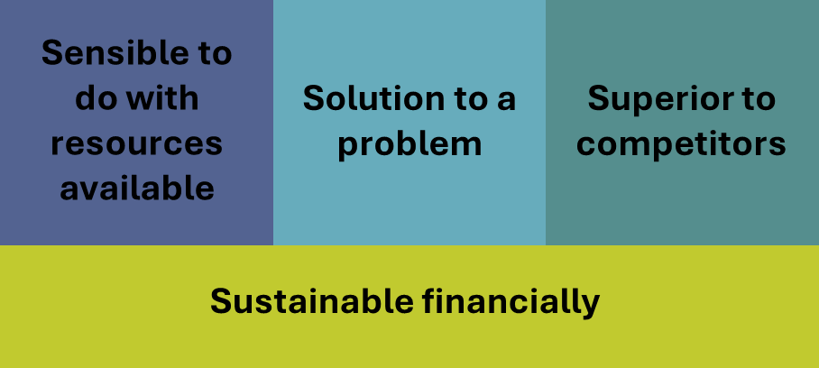
REACH Hub | Business idea sketch
Sweet to investors
There are at least nine factors related to one or more of our “S” framework that matter a lot to investors
Revenue drivers
Nature and size of market
Experience and track record of team
Nature of industry
Comparative advantage
Legal risks
Creditworthiness of owner/business and collateral
Cash flow
Key financial ratios

Slide 60
REACH Hub | Business idea sketch
Sweet to investors
Here we briefly define and provide examples of each of the factors that make businesses attractive to investors and discuss where they are considered in greater depth in the REACH-Hub
Factor | Definition / key considerations | Where considered
Revenue drivers | Ways to increase revenue – for example via recurring customers and different types of revenue | Business Pitch module
Nature and size of market | Whether there is a large and growing set of potential customers | Business plan module
Nature of industry | Are there rapid changes to your industry and is it growing? | Business plan module
Comparative advantage | Does your business have a way of being better than competitors in the long-term? | Business Pitch module
Key financial ratios | Are you performing financially according to key metrics like debt-to-equity ratios? | Financial Management module
Cash flow | Does your business have enough cash to pay for expenses and loan payments? | Financial Management module
Creditworthiness & collateral | What is the business owner and business’ credit score and is there collateral for a loan? | Debt-based Financing module
Legal risks | Are ideas and inventions protected and are there legal/insurance risks that are unaccounted for? | Business plan module
Experience and track-record of team | Is the ownership/leadership team experienced in the right way to continue growing | Business plan module

Slide 61
REACH Hub | Business idea sketch
Business idea sketch
While just initial and imperfect, the business idea sketch helps entrepreneurs to think about all major parts of a business model.
Sweet to investors
Sensible to do with resources available
Solution to a problem
Superior to competitors
Sustainable financially

Slide 62
REACH Hub | Business idea sketch
Overview
What is a business model?
The "5S" framework
Solution to a problem
Superior to competitors
Sensible to undertake given resources & partners
Sustainable financially
Sweet to investors
Summary
What’s next

Slide 63
REACH Hub | Business idea sketch
The business idea sketch can be completed on one page or on one screen using our tool which allows for space to report back on each of the key issues highlighted in this presentation.

Slide 64
REACH Hub | Business idea sketch
Below is an example of how the business idea sketch can be filled out for the worked example of a Latin American fast-casual restaurant

Slide 65
REACH Hub | Business idea sketch
Overview
What is a business model?
The "5S" framework
Solution to a problem
Superior to competitors
Sensible to undertake given resources & partners
Sustainable financially
Sweet to investors
Summary
What’s next

Slide 66
REACH Hub | Business idea sketch
Equity-based
investment
Debt-based and other financing
Introduction to financing
ESOPs
Contracts
Financial management
Accounting basics: tax & audits
Making it official & attorneys
Business plan
Basics of bookkeeping
Business pitch
Business idea sketch

Slide 67
REACH Hub | Business idea sketch
Equity-based
investment
Debt-based and other financing
Introduction to financing
ESOPs
Next steps
After engaging with this presentation on the business idea sketch, a good next step is reviewing material on putting together Business Pitches.
Contracts
Financial management
Accounting basics: tax & audits
Making it official & attorneys
Business plan
Basics of bookkeeping
Business pitch
Business idea sketch

